Slide 1
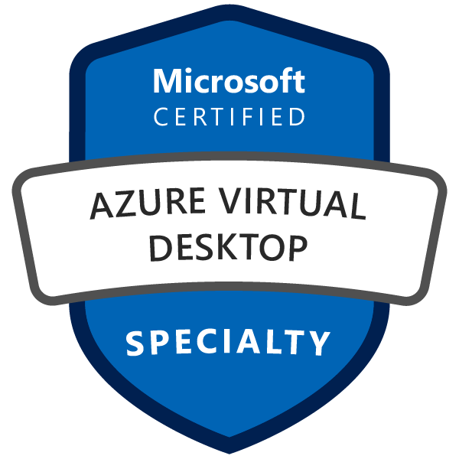
Exam AZ-140: Configuring and Operating Microsoft Azure Virtual Desktop Crash Course
Tim Warner

Slide 2


Tim Warner
Senior Content Developer w/ Microsoft
Based in Nashville, TN, US
MCT, Former MVP
Twitter: @TechTrainerTim
Badge: timw.info/avd

Slide 3
Day 1 of 2 Agenda
Introduction
Plan and implement an Azure Virtual Desktop infrastructure (40–45%)
Monitor and maintain an Azure Virtual Desktop infrastructure (10–15%)

Slide 4
Day 2 of 2 Agenda
Content catch-up
Plan and implement identity and security (15–20%)
Plan and implement user environments and apps (20–25%)
Exam AZ-140 strategy

Slide 5
Course Materials
timw.info/az140

Slide 6
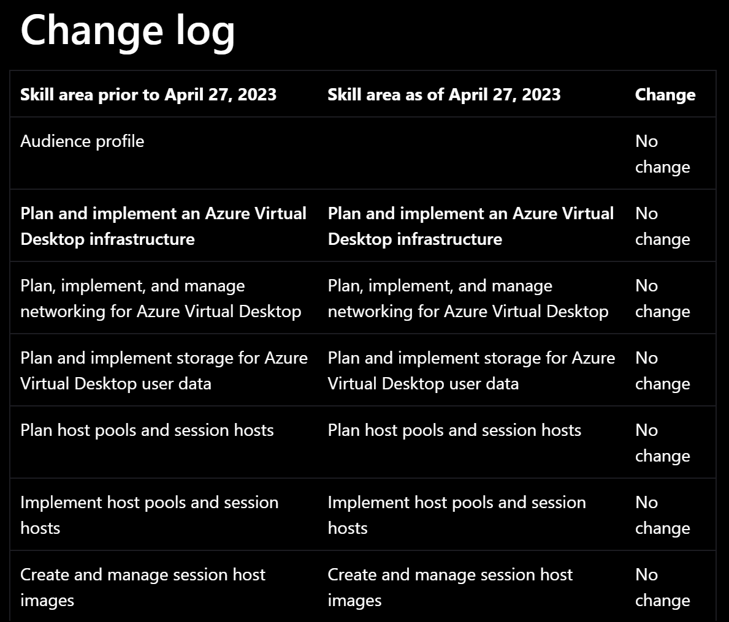
Exam AZ-140 Latest Changes

Slide 7
Level-Setting
This is a “Specialty” certification, so we move quickly and assume intermediate-level Azure skills
10-minute break at midpoint
I’m here to answer your questions – take advantage of this!
Use the Q&A panel

Slide 8
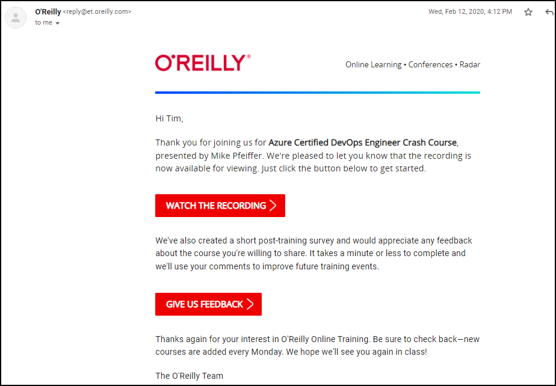
Session Recordings

Slide 9

Session Recordings

Slide 10

Session Recordings

Slide 11

Session Recordings

Slide 12


Mobile Browser: learning.oreilly.com

Slide 13



O'Reilly Mobile App

Slide 14
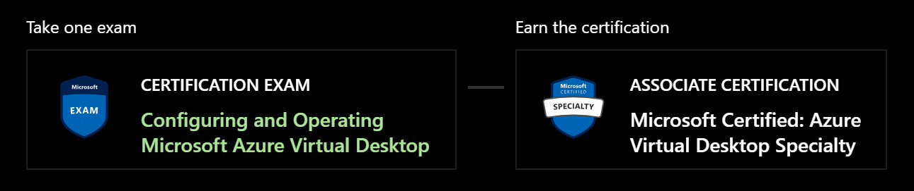
Azure Virtual Desktop Specialty
AZ-140
One-year validity

Slide 15

Tim's Certification Study Model

Slide 16
Thank you!
Course materials: timw.info/az140
Twitter: @TechTrainerTim
Work: timw.info/ps
Web: TechTrainerTim.com

Slide 17
Plan and implement AVD

Slide 18
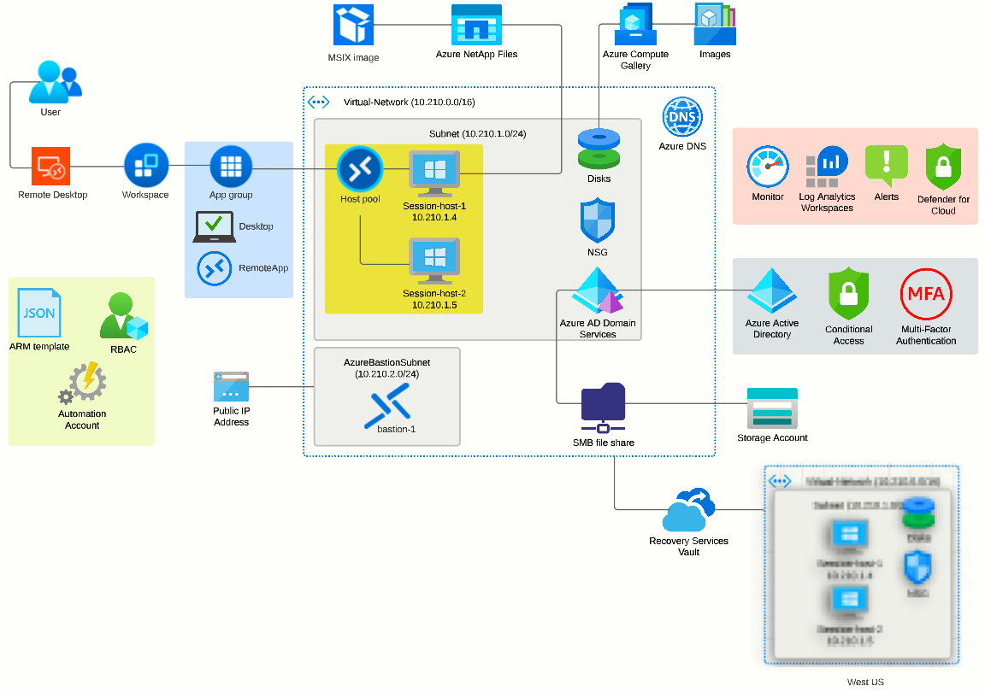

Slide 19
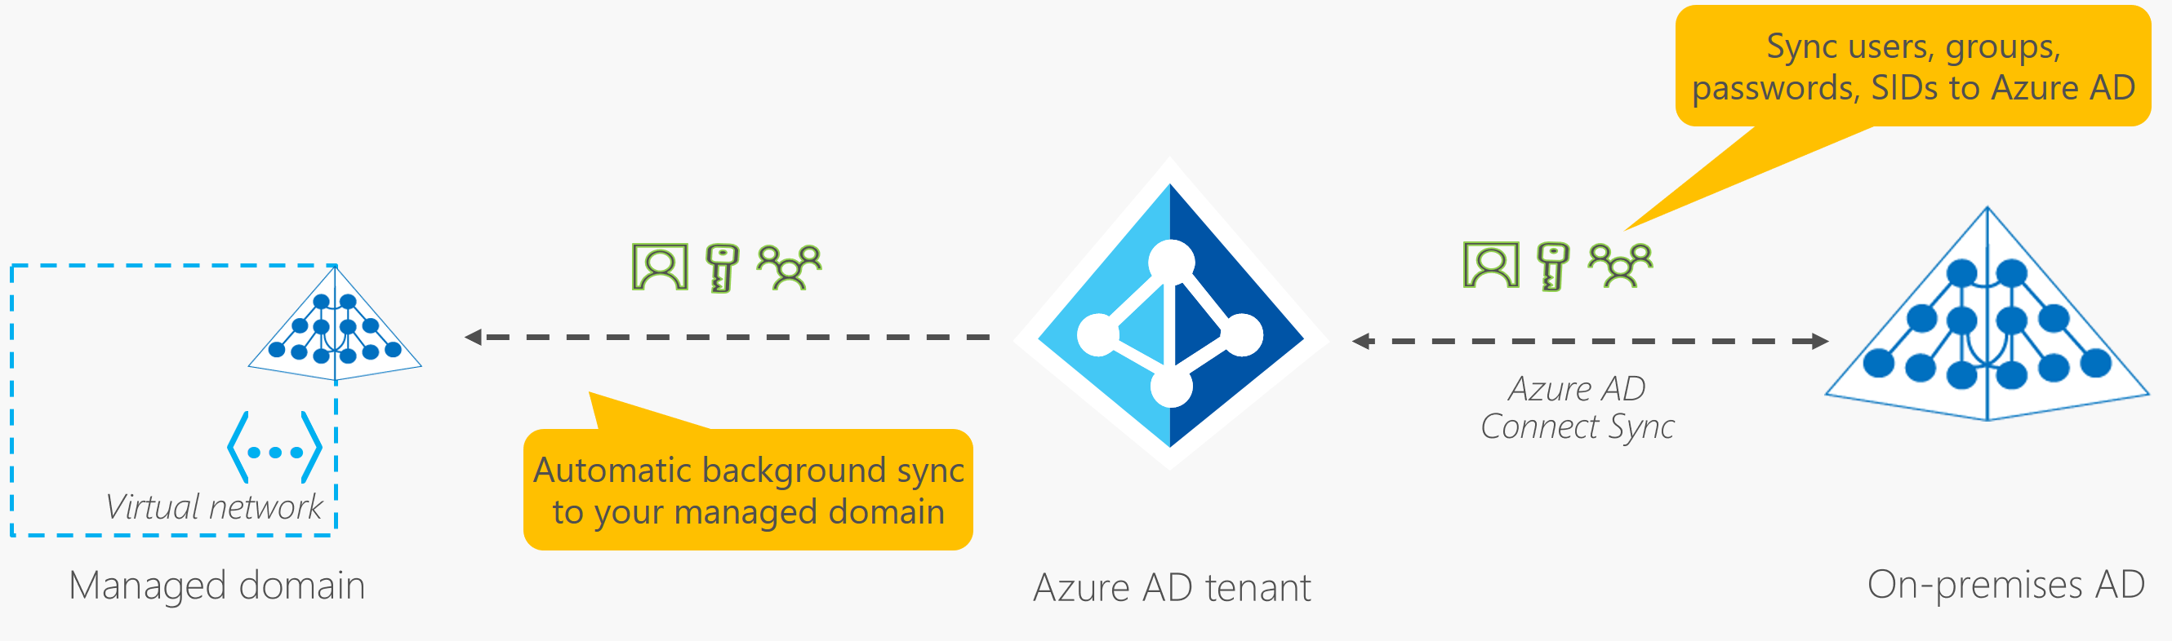
Azure AD Domain Services

Slide 20
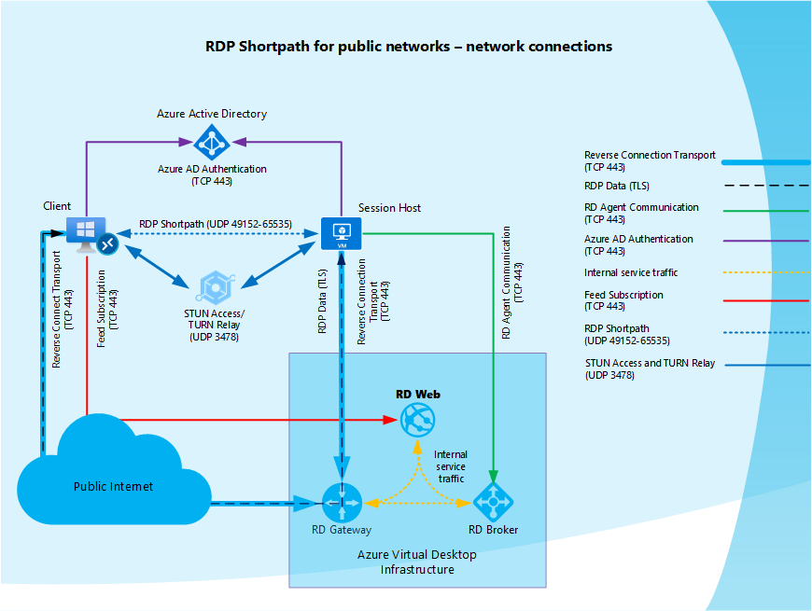
RDP Shortpath

Slide 21
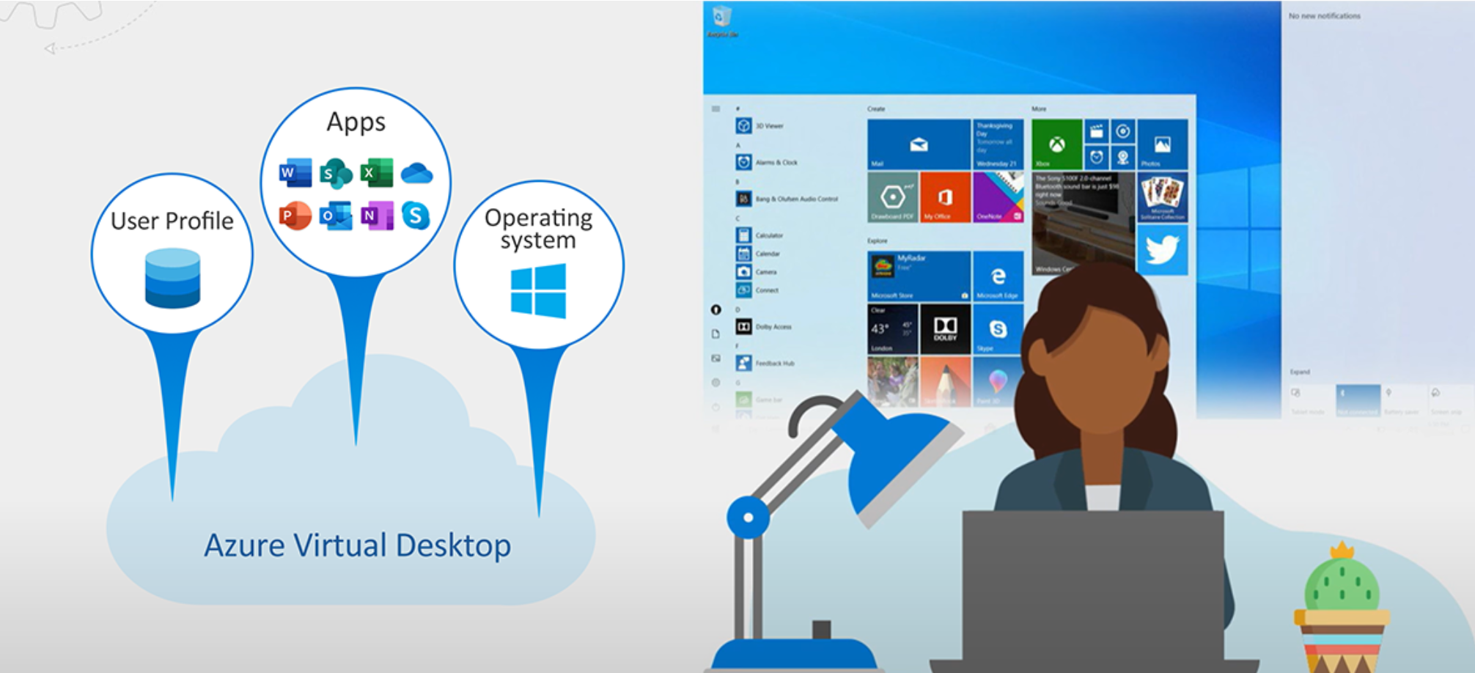
Azure Virtual Desktop is a desktop and application virtualization service that runs in Azure.
Common use cases:
Security and regulation applications: financial services, healthcare, and government.
Elastic workforce: remote workers, contractors, and partner access.
Employees: bring your own device (BYOD), mobile users, call centers, and branch workers.
Specialized workloads: design and engineering, legacy apps, and software development test.
Notes:
Azure Virtual Desktop is a desktop and application virtualization service that runs in the Azure cloud. Azure Virtual Desktop works across devices (Windows, Mac, iOS, Android, and Linux) with apps that you can use to access remote desktops and apps.
You can also use most modern browsers to access Azure Virtual Desktop-hosted experiences.
This training helps Desktop Infrastructure Architects, Cloud Architects, Desktop Administrators, or System Administrators explore Azure Virtual Desktop and build virtualized desktop infrastructure (VDI) solutions. Enterprise-scale solutions generally cover 1,000 virtual desktops and above.

Slide 22
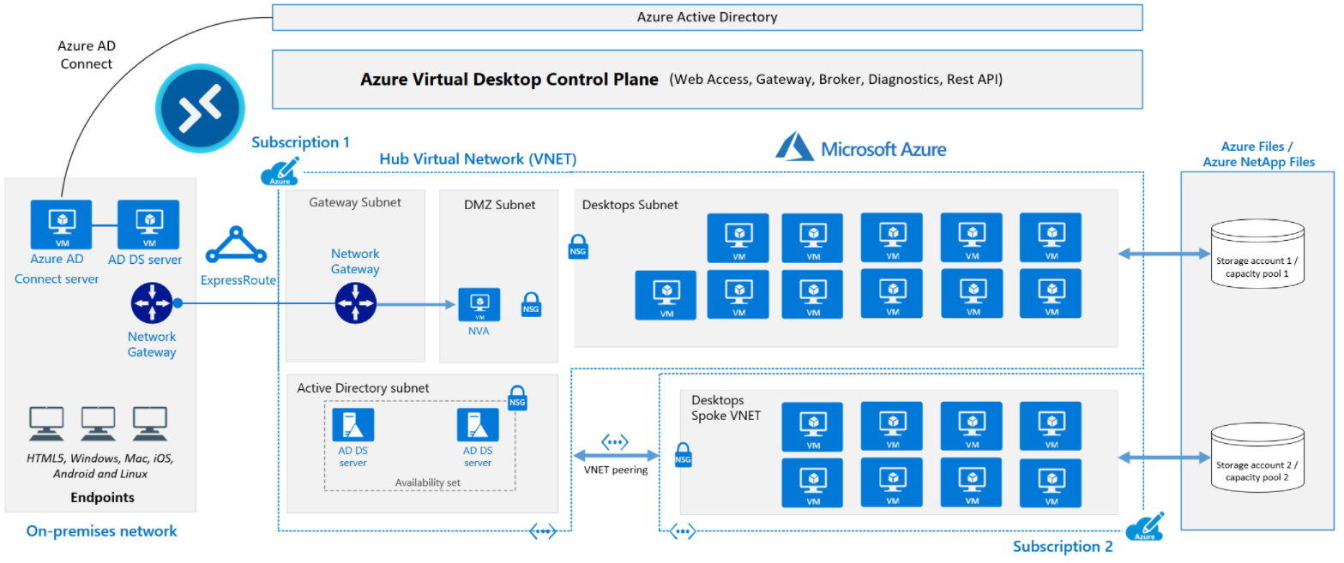
Azure Virtual Desktop for the enterprise
Notes:
The diagram shows a typical architectural setup for Azure Virtual Desktop.
The application endpoints are in the customer's on-premises network. ExpressRoute extends the on-premises network into the Azure cloud, and Azure AD Connect integrates the customer's Active Directory Domain Services (AD DS) with Azure Active Directory (Azure AD).
The Azure Virtual Desktop control plane handles Web Access, Gateway, Broker, Diagnostics, and extensibility components like REST APIs.
The customer manages AD DS and Azure AD, Azure subscriptions, virtual networks, Azure Files or Azure NetApp Files, and the Azure Virtual Desktop host pools and workspaces.
To increase capacity, the customer uses two Azure subscriptions in a hub-spoke architecture, and connects them via virtual network peering.

Slide 23
Azure Virtual Desktop components (Azure managed)
Web Access: users access virtual desktops through an HTML5-compatible browser
Gateway: connects remote users to Azure Virtual Desktop apps and desktops from any internet-connected device
Connection Broker: manages user connections to virtual desktops and apps
Diagnostics: event-based aggregator that marks each user or administrator action
Extensibility components: manage Azure Virtual Desktop using Windows PowerShell or REST APIs
Notes:
Azure Virtual Desktop service architecture is similar to Windows Server Remote Desktop Services. Microsoft manages the infrastructure and brokering components, while enterprise customers manage their own desktop host virtual machines (VMs), data, and clients.
Microsoft manages the following Azure Virtual Desktop services as part of Azure:
Web Access: The Web Access service within Window Virtual Desktop lets users access virtual desktops and remote apps through an HTML5-compatible web browser as they would with a local PC, from anywhere on any device. You can secure Web Access using multifactor authentication in Azure Active Directory.
Gateway: The Remote Connection Gateway service connects remote users to Azure Virtual Desktop apps and desktops from any internet-connected device that can run an Azure Virtual Desktop client. The client connects to a gateway, which then orchestrates a connection from a VM back to the same gateway.
Connection Broker: The Connection Broker service manages user connections to virtual desktops and remote apps. The Connection Broker provides load balancing and reconnection to existing sessions.
Diagnostics: Remote Desktop Diagnostics is an event-based aggregator that marks each user or administrator action on the Azure Virtual Desktop deployment as a success or failure. Administrators can query the event aggregation to identify failing components.
Extensibility components: Azure Virtual Desktop includes several extensibility components. You can manage Azure Virtual Desktop using Windows PowerShell or with the provided REST APIs, which also enable support from third-party tools.

Slide 24
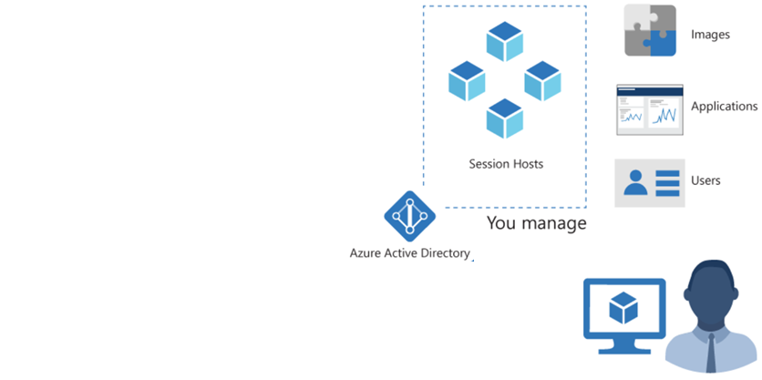
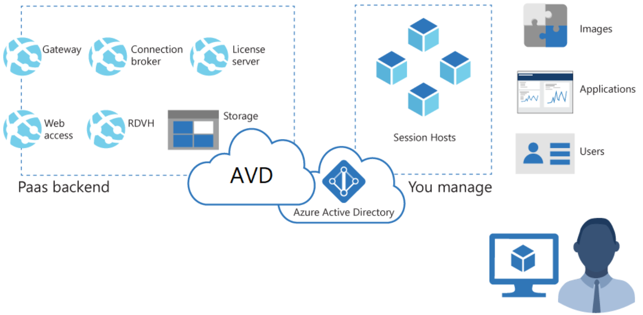
Azure Virtual Desktop components (Customer managed)
Azure Virtual Network: Connect an Azure Virtual Desktop to an on-premises network using a VPN or Azure ExpressRoute.
Azure AD: Azure Virtual Desktop uses Azure AD for identity and access management.
AD DS: Azure Virtual Desktop VMs must domain-join an AD DS service, and the AD DS must be in sync with Azure AD to associate users between the two services. You can use Azure AD Connect to associate AD DS with Azure AD.
Azure Virtual Desktop session hosts: A host pool can run the operating systems.
Notes:
Customers manage these components of Azure Virtual Desktop solutions:
Azure Virtual Network: Azure Virtual Network lets Azure resources like VMs communicate privately with each other and with the internet. By connecting Azure Virtual Desktop host pools to an Active Directory domain, you can define network topology to access virtual desktops and virtual apps from the intranet or internet, based on organizational policy. You can connect an Azure Virtual Desktop to an on-premises network using a virtual private network (VPN), or use Azure ExpressRoute to extend the on-premises network into the Azure cloud over a private connection.
Azure AD: Azure Virtual Desktop uses Azure AD for identity and access management. Azure AD integration applies Azure AD security features like conditional access, multi-factor authentication, and the Intelligent Security Graph, and helps maintain app compatibility in domain-joined VMs.
AD DS: Azure Virtual Desktop VMs must domain-join an AD DS service, and the AD DS must be in sync with Azure AD to associate users between the two services. You can use Azure AD Connect to associate AD DS with Azure AD.
Azure Virtual Desktop session hosts: A host pool can run the following operating systems:
Windows 7 Enterprise
Windows 10 Enterprise
Windows 10 Enterprise Multi-session
Windows Server 2012 R2 and above
Custom Windows system images with pre-loaded apps, group policies, or other customizations
Azure Virtual Desktop workspace: The Azure Virtual Desktop workspace or tenant is a management construct to manage and publish host pool resources.

Slide 25
Minimum recommended bandwidths for a smooth user experience for using applications:
Workload type | Recommended bandwidth
Light | 1.5 Mbps
Medium | 3 Mbps
Heavy | 5 Mbps
Power | 15 Mbps
Bandwidth recommendations for a smooth user experience for display resolutions:
Typical display resolutions at 30 fps | Recommended bandwidth
About 1024 × 768 px | 1.5 Mbps
About 1280 × 720 px | 3 Mbps
About 1920 × 1080 px | 5 Mbps
About 3840 × 2160 px (4K) | 15 Mbps
Notes:
When using a remote Windows session, your network's available bandwidth greatly impacts the quality of your experience. Different applications and display resolutions require different network configurations, so it's important to make sure your network is configured to meet your needs.
The following recommendations apply to networks with less than 0.1% loss. These recommendations apply regardless of how many sessions you're hosting on your virtual machines (VMs).
Applications
The first table lists the minimum recommended bandwidths for a smooth user experience.
Keep in mind that the stress put on your network depends on both your app workload's output frame rate and your display resolution. If either the frame rate or display resolution increases, the bandwidth requirement will also rise. For example, a light workload with a high-resolution display requires more available bandwidth than a light workload with regular or low resolution.
Display resolutions
Different display resolutions require different available bandwidths. The following table lists the bandwidths we recommend for a smooth user experience at typical display resolutions with a frame rate of 30 frames per second (fps). These recommendations apply to single and multiple user scenarios. Keep in mind that scenarios involving a frame rate under 30 fps, such as reading static text, require less available bandwidth.

Slide 26
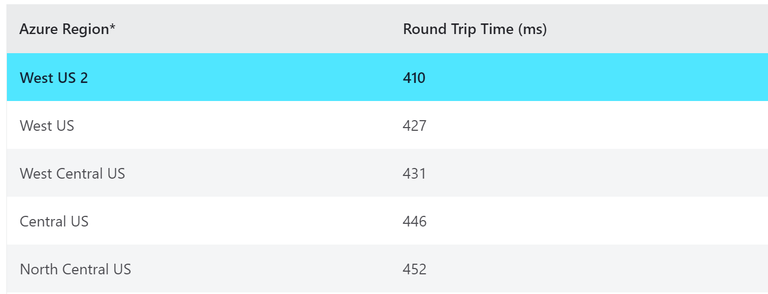
Use the Azure Virtual Desktop Experience Estimator to determine the connection RTT from your location to each Azure region you can deploy VMs
Connection round trip time from your current location
Azure region in which you can deploy virtual machines
Through the Azure Virtual Desktop service
Notes:
Use the Azure Virtual Desktop Experience Estimator to determine the connection round trip time (RTT) from your current location, through the Azure Virtual Desktop service, to each Azure region in which you can deploy virtual machines.
The highlighted Azure region is the one with the lowest connection RTT from your current location. The times displayed are estimates intended to help assess end user experience quality for your Azure Virtual Desktop deployment. The actual experience will vary depending on network conditions, end user device, and the configuration of the deployed virtual machines.

Slide 27
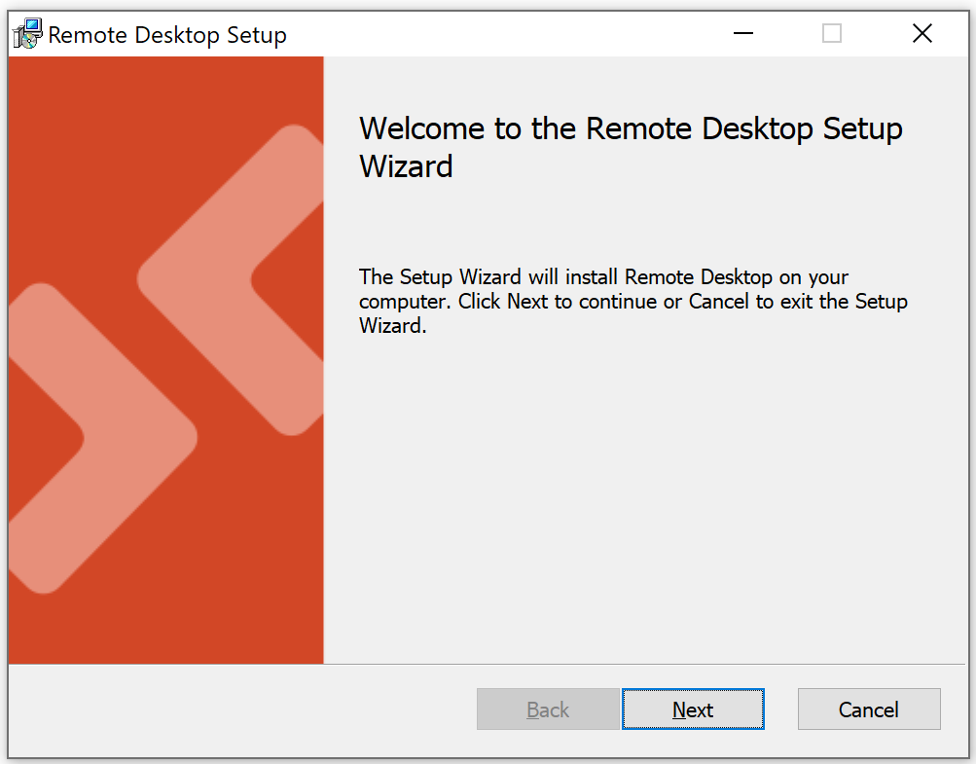
Access Azure Virtual Desktop resources on devices with Windows 10, Windows 10 IoT Enterprise, and Windows 7 using the Windows Desktop client.
Choose the client that matches your version of Windows:
Windows 64-bit
Windows 32-bit
Windows ARM64
NOTE: The client doesn't support Window 8 or Windows 8.1.
Notes:
Once installed, the client can be launched from the Start menu by searching for Remote Desktop.
Azure Virtual Desktop doesn't support the RemoteApp and Desktop Connections (RADC) client or the Remote Desktop Connection (MSTSC) client.

Slide 28

Balancing host pools

Slide 29
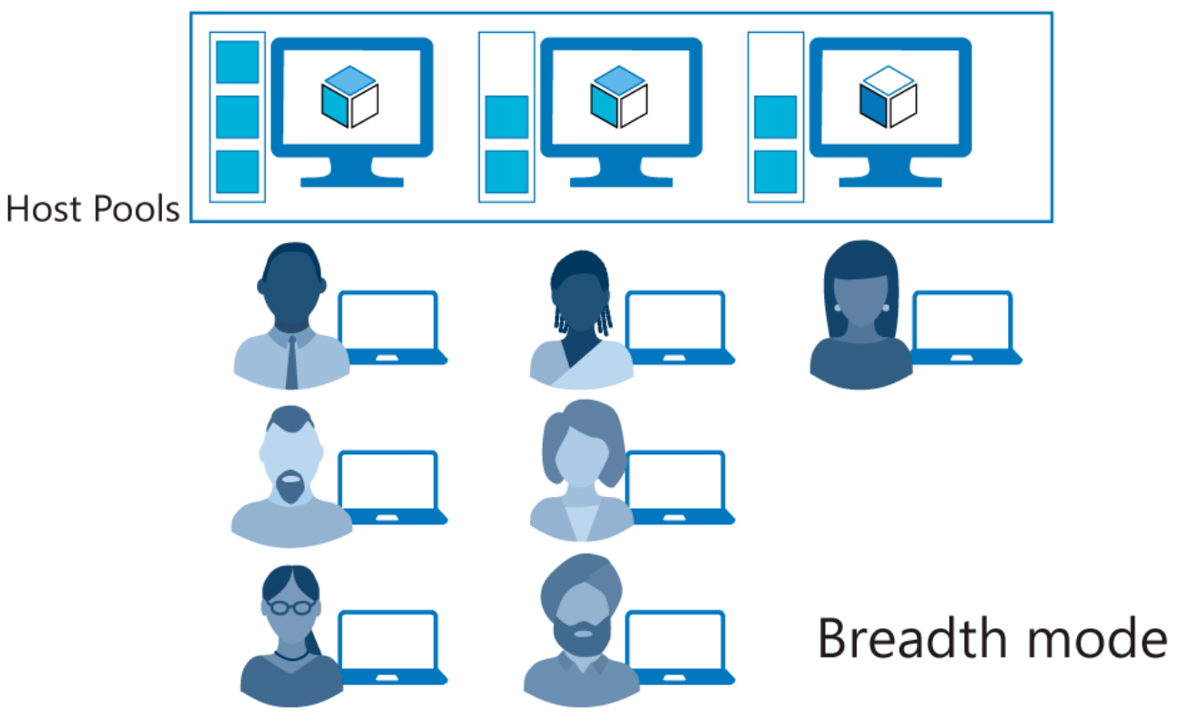
Breadth-first load-balancing method
Ideal for providing the best experience for users connecting to their pooled virtual desktop environment.
Notes:
Azure Virtual Desktop supports two load-balancing methods. Each method determines which session host will host a user's session when they connect to a resource in a host pool.
The following load-balancing methods are available in Azure Virtual Desktop:
Each host pool can only configure one type of load-balancing specific to it. However, both load-balancing methods share the following behaviors no matter which host pool they're in:
If a user already has a session in the host pool and is reconnecting to that session, the load balancer will successfully redirect them to the session host with their existing session. This behavior applies even if that session host's AllowNewConnections property is set to False.
If a user doesn't already have a session in the host pool, then the load balancer won't consider session hosts whose AllowNewConnections property is set to False during load balancing.
Breadth-first load-balancing methodBreadth-first load balancing allows you to evenly distribute user sessions across the session hosts in a host pool.
Depth-first load balancing allows you to saturate a session host with user sessions in a host pool. Once the first session reaches its session limit threshold, the load balancer directs any new user connections to the next session host in the host pool until it reaches its limit, and so on.
The breadth-first load-balancing method allows you to distribute user connections to optimize for this scenario. This method is ideal for organizations that want to provide the best experience for users connecting to their pooled virtual desktop environment.
The breadth-first method first queries session hosts that allow new connections. The method then selects a session host randomly from half the set of session hosts with the least number of sessions. For example, if there are nine machines with 11, 12, 13, 14, 15, 16, 17, 18, and 19 sessions, a new session you create won't automatically go to the first machine. Instead, it can go to any of the first five machines with the lowest number of sessions (11, 12, 13, 14, 15).

Slide 30
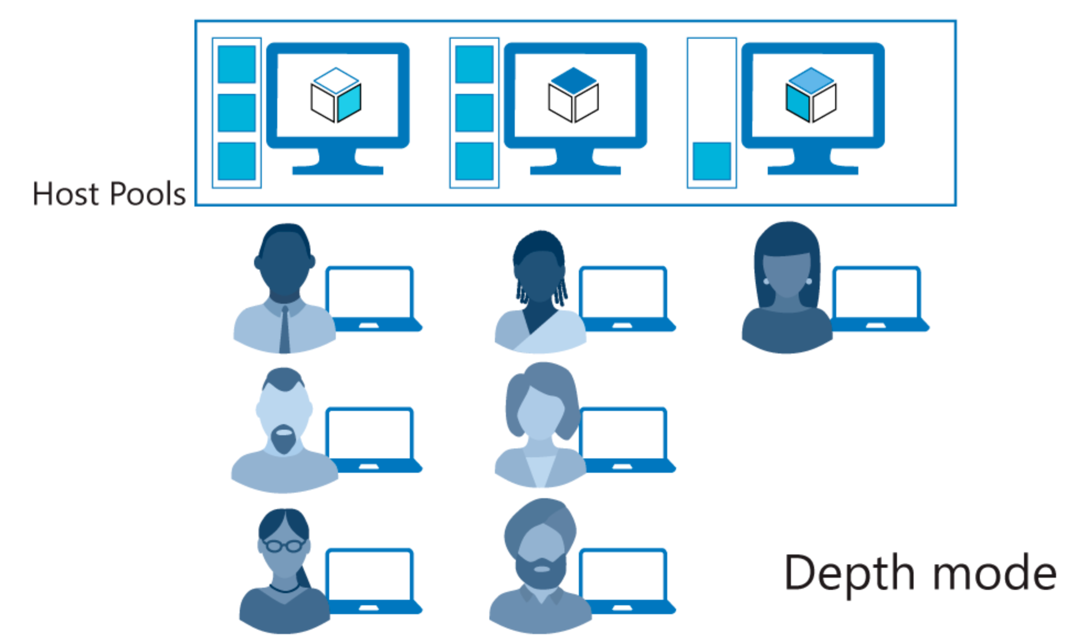
Depth-first load-balancing method
Ideal for cost-conscious organizations that want more granular control on the number of virtual machines they've allocated for a host pool.
Notes:
The depth-first method first queries session hosts that allow new connections and haven't gone over their maximum session limit. The method then selects the session host with highest number of sessions. If there's a tie, the method selects the first session host in the query.
The depth-first load balancing algorithm distributes sessions to session hosts based on the maximum session host limit. This parameter is required when you use the depth-first load balancing algorithm. For the best possible user experience, make sure to change the maximum session host limit parameter to a number that best suits your environment.

Slide 31
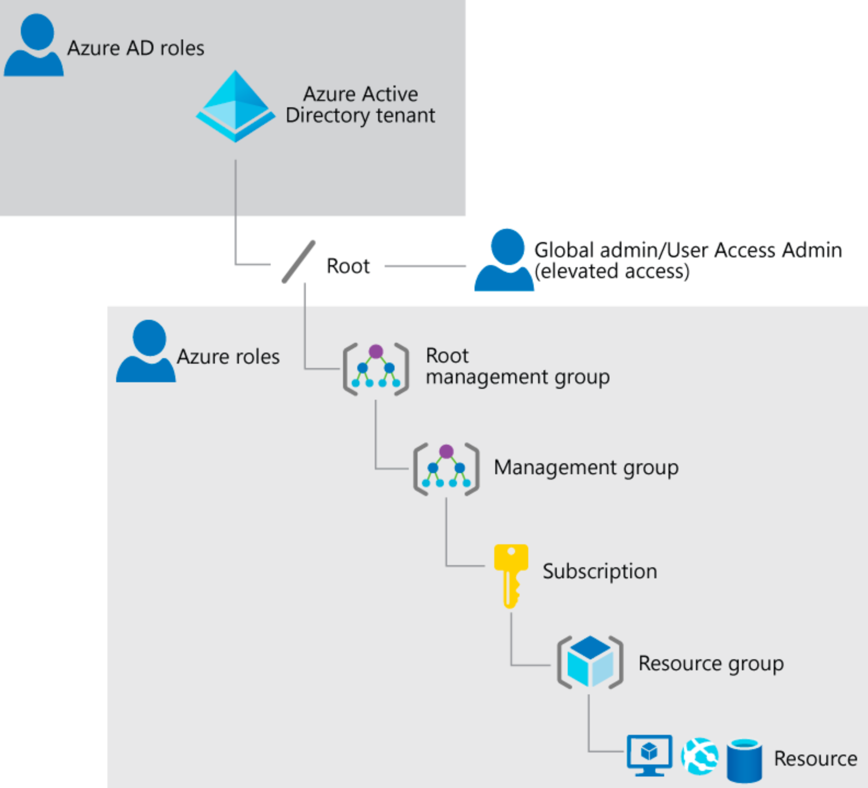
A Global Administrator in Azure AD may need to elevate access to access subscriptions and management groups, such as:
Regain access to an Azure subscription or management group when a user has lost access
Grant another user access to an Azure subscription or management group
See all Azure subscriptions or management groups in an organization
Allow an automation app to access all Azure subscriptions or management groups
Notes:
Some Azure Virtual Desktop procedures, such as installing Office on a master VHD image, assume you have elevated access on the VM, whether it's provisioned in Azure or Hyper-V Manager.
As a Global Administrator in Azure Active Directory (Azure AD), you might not have access to all subscriptions and management groups in your directory. Below are methods to elevate access to all subscriptions and management groups.
Why would you need to elevate your access?
Global Administrators should consider the following scenarios for elevating access.
Regain access to an Azure subscription or management group when a user has lost access.
Grant another user or yourself access to an Azure subscription or management group.
See all Azure subscriptions or management groups in an organization.
Allow an automation app (such as an invoicing or auditing app) to access all Azure subscriptions or management groups.

Slide 32
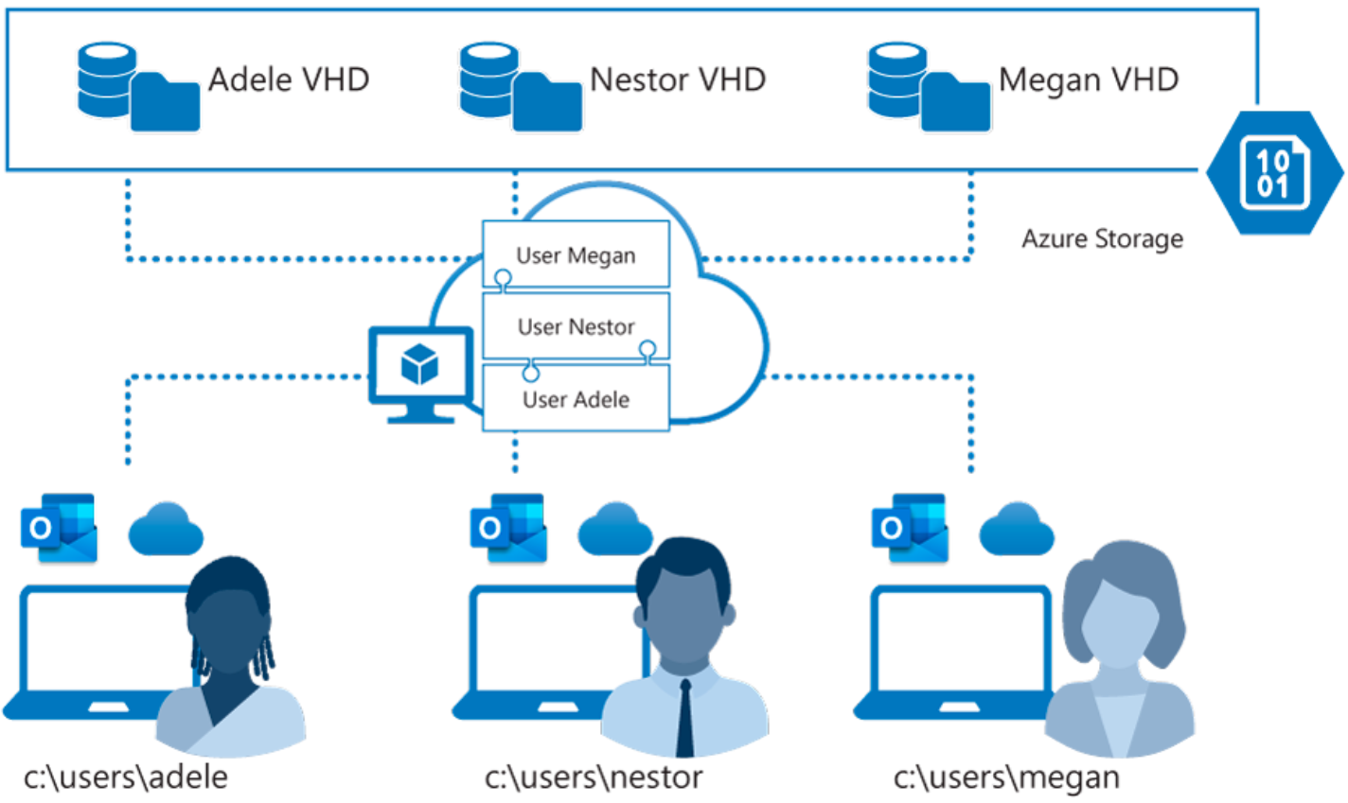
FSLogix is designed to roam profiles in remote computing environments, such as Azure Virtual Desktop
At sign-in, a container is dynamically attached to the computing environment using a natively supported VHD and a VHDX
The user profile is immediately available and appears in the system exactly like a native user profile
Notes:
Azure offers multiple storage solutions that you can use to store your FSLogix profile container. This topic compares storage solutions that Azure offers for Azure Virtual Desktop FSLogix user profile containers.
We recommend storing FSLogix profile containers on Azure Files for most of our customers.
Azure Virtual Desktop offers FSLogix profile containers as the recommended user profile solution. FSLogix is designed to roam profiles in remote computing environments, such as Azure Virtual Desktop.
At sign-in, this container is dynamically attached to the computing environment using a natively supported Virtual Hard Disk (VHD) and a Hyper-V Virtual Hard Disk (VHDX). The user profile is immediately available and appears in the system exactly like a native user profile.

Slide 33
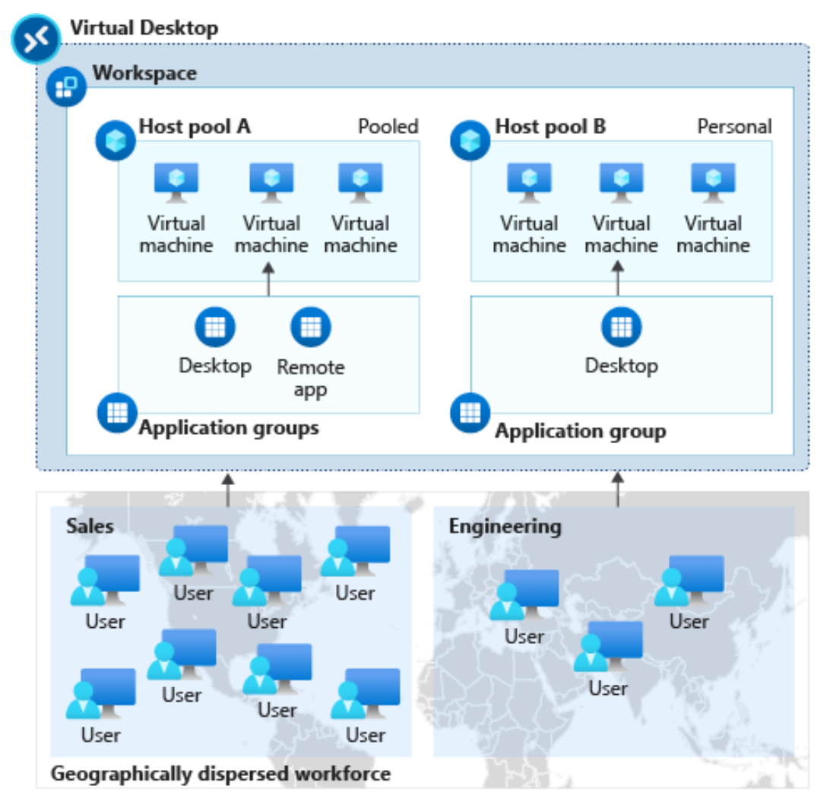
The diagram below shows an Azure Virtual Desktop workspace with two host pools:
Host pool A has two application groups: Desktop and RemoteApp. These resources are shared (pooled) across the sales team.
Host pool B has a Desktop application group with personal desktops available to an engineering team.
Notes:
Remote Desktop client for Windows Desktop
You use the Remote Desktop client for Windows Desktop to access Windows apps and desktops remotely from a different Windows device.
NOTE: This topic is not intended for the Remote Desktop Connection (MSTSC) client that ships with Windows. This topic is for the new Remote Desktop (MSRDC) client.
The Remote Desktop client (MSRDC) supports:
Windows 10
Windows 10 IoT Enterprise
Windows 7 client devices
Choose the client that matches the version of Windows.
Windows 64-bit
Windows 32-bit
Windows ARM64
You launch it from the Start menu by searching for Remote Desktop.
Workspaces
Get the list of managed resources you can access, such as apps and desktops, by subscribing to the Workspace your admin provided you. When you subscribe, the resources become available on your local PC. The Windows Desktop client currently supports resources published from Azure Virtual Desktop.
The diagram in the slide shows an Azure Virtual Desktop workspace with two host pools.
Host pool A has two application groups: Desktop and RemoteApp. These resources are shared (pooled) across the sales team.
Host pool B has a Desktop application group with personal desktops available to an engineering team.

Slide 34
Remote Desktop web client uses a compatible web browser to access remote resources (apps and desktops) published to you by your admin.
For access to remote apps and desktops, users need:
A domain
Username
Password
URL (provided by the admin)
A supported web browser
Notes:
The Remote Desktop web client lets you use a compatible web browser to access your organization's remote resources (apps and desktops) published to you by your admin. You'll be able to interact with the remote apps and desktops like you would with a local PC no matter where you are, without having to use another desktop computer.
Once your admin sets up your remote resources all you need are your domain, user name, password, the URL your admin sent you, and web browser.
The web client doesn't currently have mobile OS support.
What you'll need to use the web client:
For the web client, you'll need a PC running Windows, macOS, ChromeOS, or Linux.
A modern browser like Microsoft Edge, Internet Explorer 11, Google Chrome, Safari, or Mozilla Firefox (v55.0 and later).
The URL your admin sent you.
Using the Remote Desktop client
To sign into the client, go to the URL your admin sent you. At the sign in page, enter your domain and user name in the format DOMAIN\username, enter your password, and then select Sign in.
After you sign in, the client will take you to the All Resources tab, which contains all items published to you under one or more collapsible groups, such as the "Work Resources" group. You'll see several icons representing the apps, desktops, or folders containing more apps or desktops that the admin has made available to the work group. You can come back to this tab at any time to launch additional resources.
To start using an app or desktop, select the item you want to use, enter the same user name and password you used to sign in to the web client if prompted, and then select Submit.
You might also be shown a consent dialog to access local resources, like clipboard and printer. You can choose to not redirect either of these, or select Allow to use the default settings.
Wait for the web client to establish the connection, and then start using the resource as you would normally.

Slide 35
Deploying using group policies or the Microsoft Endpoint Configuration Manager lets you run the installer silently using a command line.
Per-device installation, run:
msiexec.exe /i <path to the MSI> /qn ALLUSERS=1
Per-user installation, run:
msiexec.exe /i `<path to the MSI>` /qn ALLUSERS=2 MSIINSTALLPERUSER=1
Notes:
Your users can install the client directly after downloading it. If you're deploying to multiple devices, you may want to also deploy the client to them through other means. Deploying using group policies or the Microsoft Endpoint Configuration Manager lets you run the installer silently using a command line. Run the following commands to deploy the client per-device or per-user.
Configure update notifications
The client notifies you whenever there's an update and automatically updates itself when the client is closed and has no active connections. Even with no active connections, the msrdc.exe process runs in the background to allow you to reconnect quickly when you reopen the client. You can stop msrdc.exe by right-clicking on the Azure Virtual Desktop icon in the system tray area and selecting Disconnect all sessions in the drop-down menu.
Insider group
The Insider group is for early validation, and consists of admins and their selected users. The Insider group serves as a test run to detect any issues in the update that can impact performance before it's released to the Public group.
It’s a good idea for each organization to have some users in the Insider group to test updates and catch issues early.
In the Insider group, a new version of the client is released to the users on the second Tuesday of each month for early validation. If the update doesn't have issues, it gets released to the Public group two weeks later. Users in the Insider group will receive update notifications automatically whenever updates are ready.
Public group
This group is for all users and is the most stable version. You don't need to do anything to configure this group.
The Public group receives the version of the client that was tested by the Insider group every fourth Tuesday of each month. All users in the Public group will receive an update notification if that setting is enabled.

Slide 36
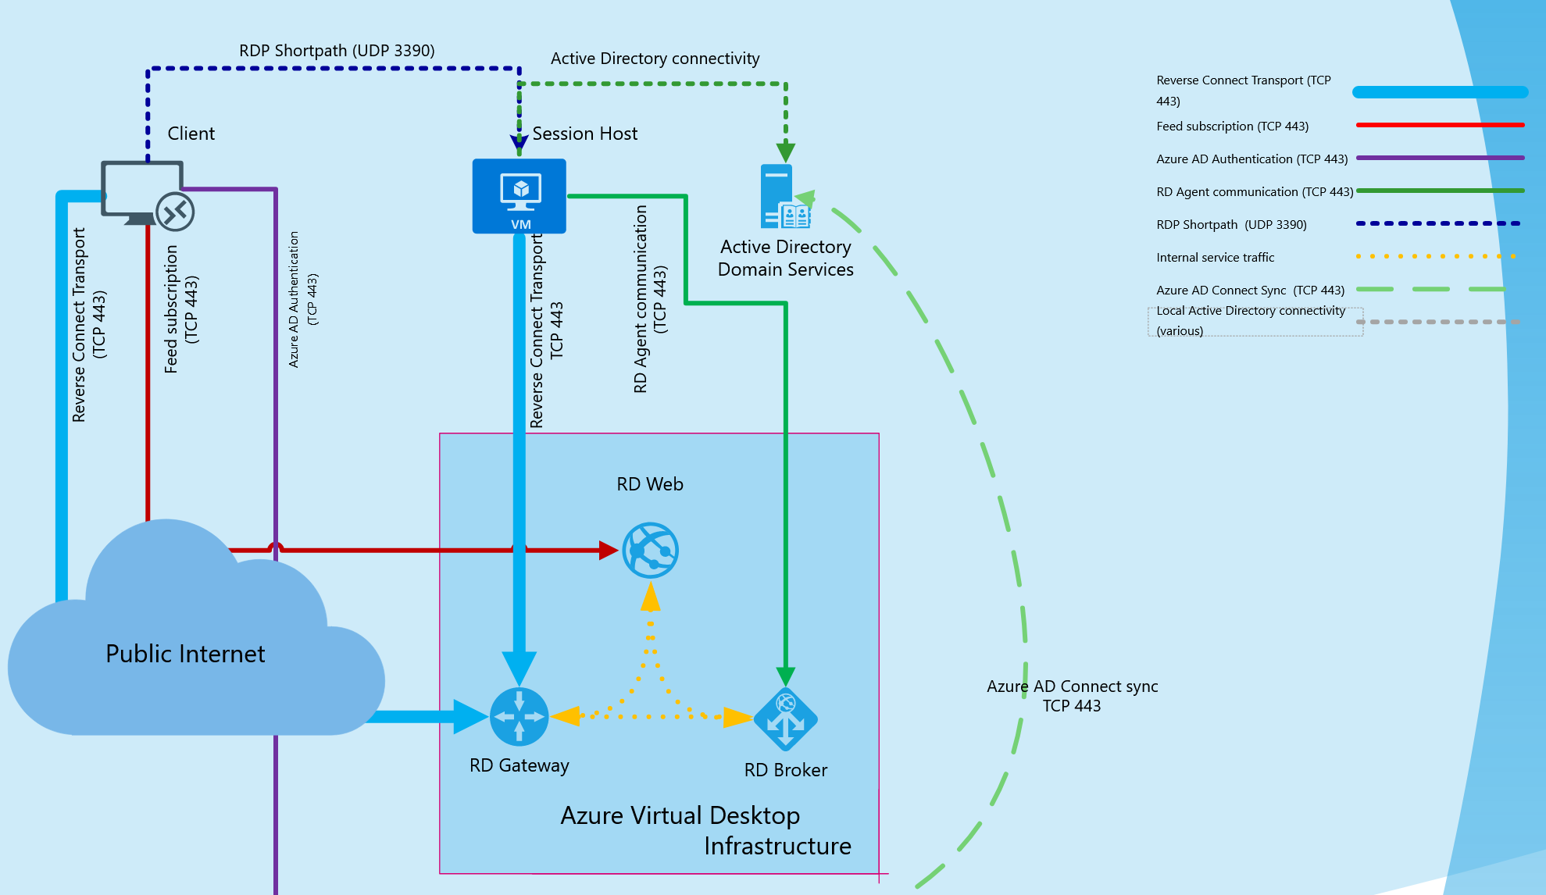
Azure Virtual Desktop RDP Shortpath for managed networks
Notes:
RDP Shortpath for managed networks is a feature of Azure Virtual Desktop that establishes a direct UDP-based transport between Remote Desktop Client and Session host. RDP uses this transport to deliver Remote Desktop and RemoteApp while offering better reliability and consistent latency.
RDP Shortpath transport is based on the Universal Rate Control Protocol (URCP). URCP enhances UDP with active monitoring of the network conditions and provides fair and full link utilization. URCP operates at low delay and loss levels as needed by Remote Desktop. URCP achieves the best performance by dynamically learning network parameters and providing protocol with a rate control mechanism.
RDP Shortpath establishes the direct connectivity between the Remote Desktop client and the session host. Direct connectivity reduces dependency on the Azure Virtual Desktop gateways, improves the connection's reliability, and increases available bandwidth for each user session.
The removal of extra relay reduces round-trip time, which improves user experience with latency-sensitive applications and input methods.
RDP Shortpath brings support for configuring Quality of Service (QoS) priority for RDP connections through Differentiated Services Code Point (DSCP) marks
RDP Shortpath transport allows limiting outbound network traffic by specifying a throttle rate for each session.
Here's how the session host negotiates multi-transport capabilities:
The session host sends the list of its private and public IPv4 and IPv6 addresses to the client.
The client starts the background thread to establish a parallel UDP-based transport directly to one of the host's IP addresses.
While the client is probing the provided IP addresses, it continues the initial connection establishment over the reverse connect transport to ensure no delay in the user connection.
If the client has a direct line of sight, the client establishes a secure TLS connection with the session host.
After establishing the Shortpath transport, RDP moves all Dynamic Virtual Channels (DVCs), including remote graphics, input, and device redirection, to the new transport.
If a firewall or network topology prevents the client from establishing direct UDP connectivity, RDP continues with a reverse connect transport.

Slide 37
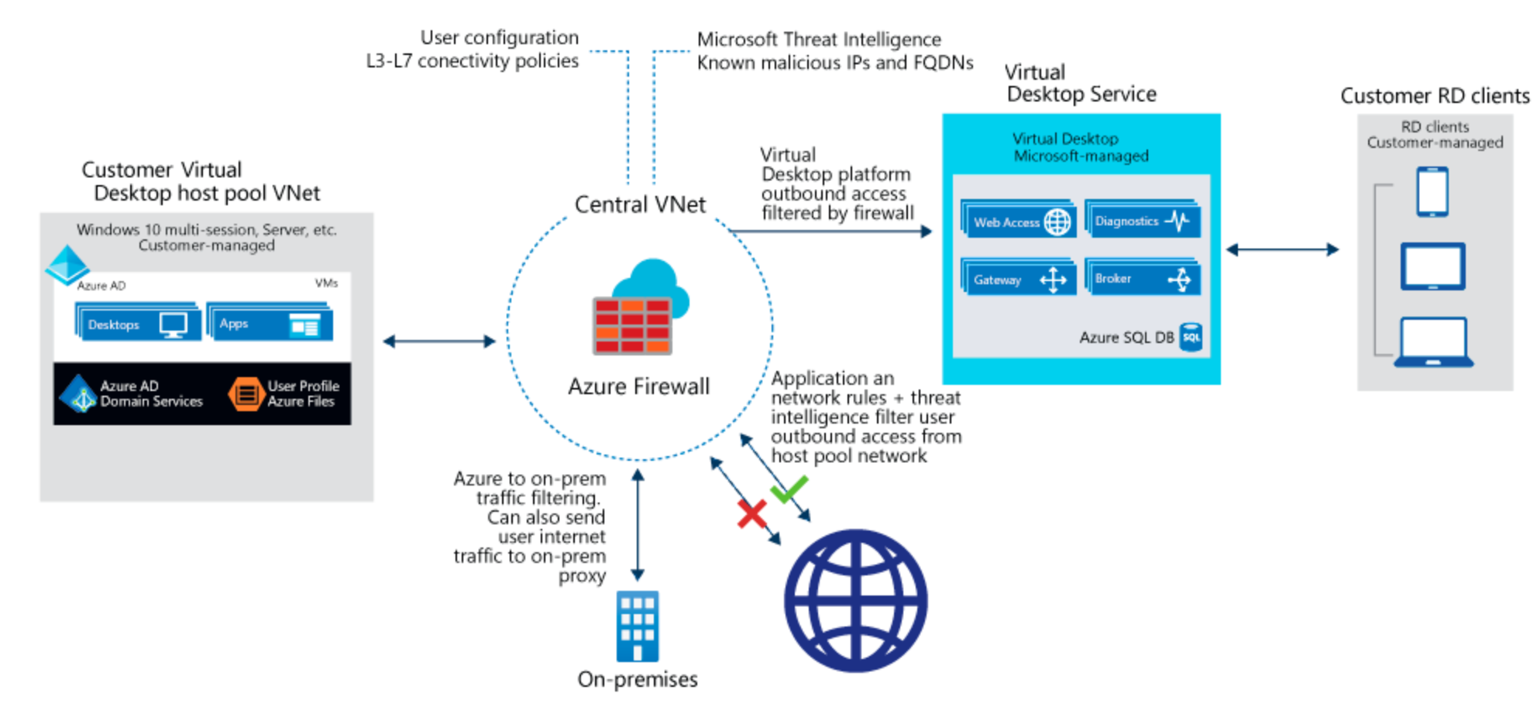
A host pool is a collection of Azure virtual machines that register to Azure Virtual Desktop as session hosts.
These virtual machines run in your virtual network and are subject to the virtual network security controls.
They need outbound Internet access to the Azure Virtual Desktop service to operate properly and might also need outbound Internet access for end users.
Azure Firewall can help you lock down your environment and filter outbound traffic.
Notes:
The Azure virtual machines you create for Azure Virtual Desktop must have access to several Fully Qualified Domain Names (FQDNs) to function properly. Azure Firewall provides an Azure Virtual Desktop FQDN Tag to simplify this configuration. Use the following steps to allow outbound Azure Virtual Desktop platform traffic:
Deploy Azure Firewall and configure your Azure Virtual Desktop host pool subnet User Defined Route (UDR) to route all traffic via the Azure Firewall. Your default route now points to the firewall.
Create an application rule collection and add a rule to enable the WindowsVirtualDesktop FQDN tag. The source IP address range is the host pool virtual network, the protocol is https, and the destination is WindowsVirtualDesktop.
The set of required storage and service bus accounts for your Azure Virtual Desktop host pool is deployment-specific. It isn't captured in the WindowsVirtualDesktop FQDN tag.
Create a network rule collection add the following rules:
Allow DNS – allow traffic from your ADDS private IP address to * for TCP and UDP ports 53.
Allow KMS – allow traffic from your Azure Virtual Desktop virtual machines to Windows Activation Service TCP port 1688.
Some deployments may not need DNS rules, for example Azure Active Directory Domain controllers forward DNS queries to Azure DNS at 168.63.129.16.

Slide 38
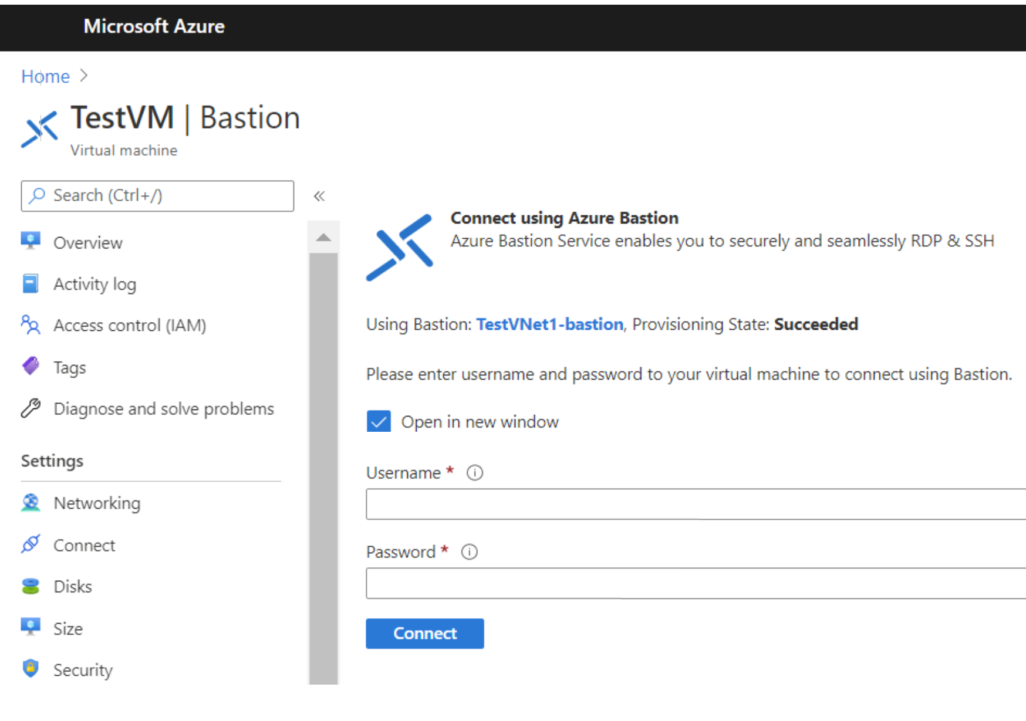
Microsoft Bastion provides secure connectivity to all VMs in a virtual network in which it is provisioned.
Using Microsoft Bastion protects your virtual machines from exposing RDP/SSH ports to the outside world, while still providing secure access using RDP/SSH.
Notes:
Microsoft Bastion provides secure connectivity to all VMs in a virtual network in which it is provisioned. Using Azure Bastion protects your virtual machines from exposing RDP/SSH ports to the outside world, while still providing secure access using RDP/SSH.
Before you begin, verify that you have met the following criteria:
A VNet with the Bastion host already installed. Make sure that you have set up an Azure Bastion host for the virtual network in which the VM is located. Once the Bastion service is provisioned and deployed in your virtual network, you can use it to connect to any VM in the virtual network.
A Windows virtual machine in the virtual network.
The following required roles:
Reader role on the virtual machine.
Reader role on the NIC with private IP of the virtual machine.
Reader role on the Azure Bastion resource.

Slide 39
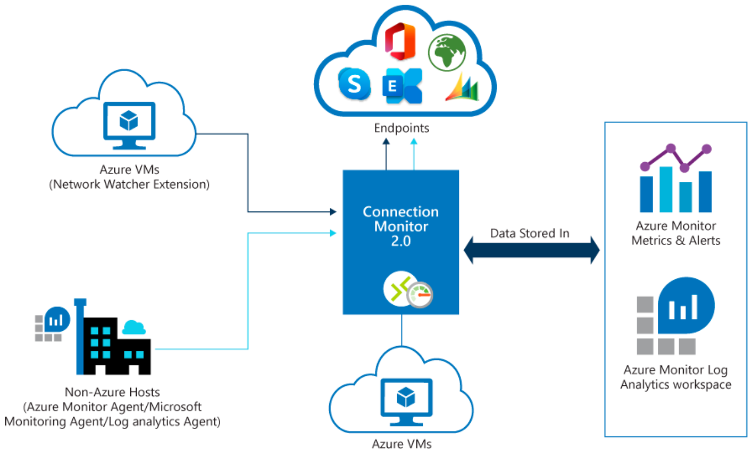
Azure Network Watcher provides tools to monitor, diagnose, view metrics, and enable or disable logs for resources in an Azure virtual network.
Connection Monitor 2.0 monitors communication at a regular interval and informs you of reachability, latency, and network topology changes between the VM and the endpoint.
If an endpoint becomes unreachable, connection troubleshoot informs you of the reason.
Notes:
Azure Network Watcher provides tools to monitor, diagnose, view metrics, and enable or disable logs for resources in an Azure virtual network.
Network Watcher is designed to monitor and repair the network health of IaaS (Infrastructure-as-a-Service) including virtual machines, virtual networks, application gateways, and load balancers.
Monitor communication between a virtual machine and an endpoint
Endpoints can be another virtual machine (VM), a fully qualified domain name (FQDN), a uniform resource identifier (URI), or IPv4 address.
Connection Monitor 2.0 monitors for availability, latency, and network topology changes between the virtual machine and the endpoint.
If an endpoint becomes unreachable, Connection Monitor informs you. Potential issues are DNS name resolution problems, CPU, memory, or firewall within the operating system of a virtual machine.

Slide 40
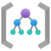
Plan and implement Remote Desktop Protocol Short path

Slide 41
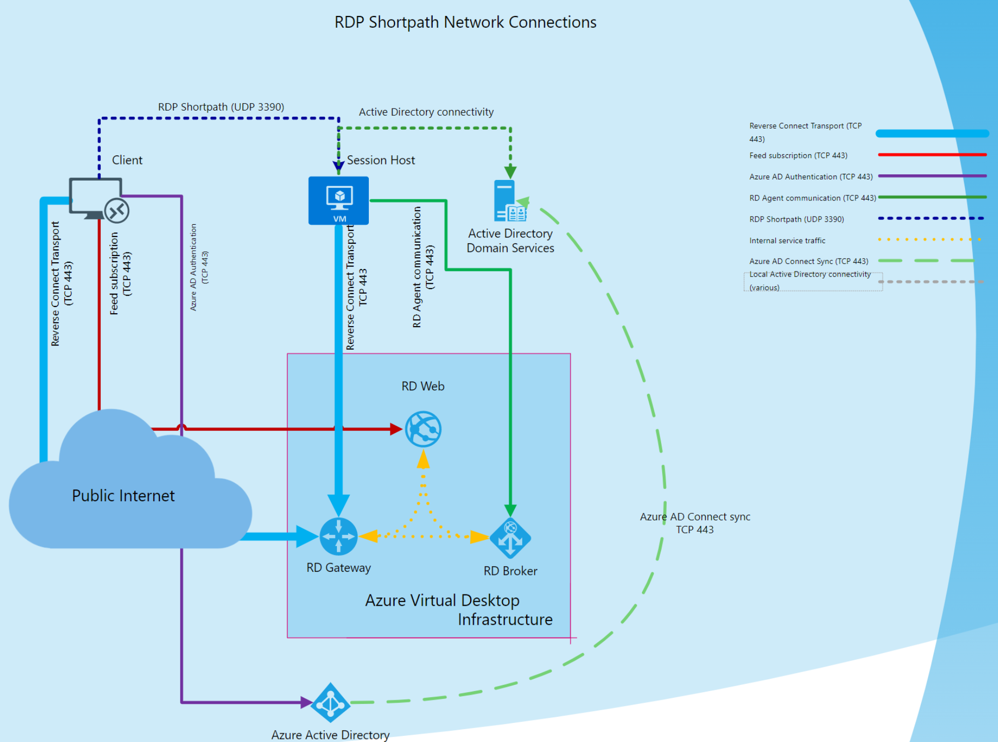
The session host sends the list of its private and public IPv4 and IPv6 addresses to the client.
The client starts the background thread to establish a parallel UDP-based transport directly to one of the host's IP addresses.
Initial connection establishment over the reverse connect transport to ensure no delay in the user connection.
If the client has a direct line of sight, the client establishes a secure TLS connection with the session host.
RDP moves all Dynamic Virtual Channels (DVCs).
If a firewall or network topology prevents the client from establishing direct UDP connectivity, RDP continues with a reverse connect transport.
Notes:
After establishing the reverse connect transport, the client and session host starts the RDP connection and negotiates the multi-transport capabilities.
The session host negotiates multi-transport capabilities:
The session host sends the list of its private and public IPv4 and IPv6 addresses to the client.
The client starts the background thread to establish a parallel UDP-based transport directly to one of the host's IP addresses.
While the client is probing the provided IP addresses, it continues the initial connection establishment over the reverse connect transport to ensure no delay in the user connection.
If the client has a direct line of sight, the client establishes a secure TLS connection with the session host.
After establishing the Shortpath transport, RDP moves all Dynamic Virtual Channels (DVCs), including remote graphics, input, and device redirection, to the new transport.
If a firewall or network topology prevents the client from establishing direct UDP connectivity, RDP continues with a reverse connect transport.

Slide 42
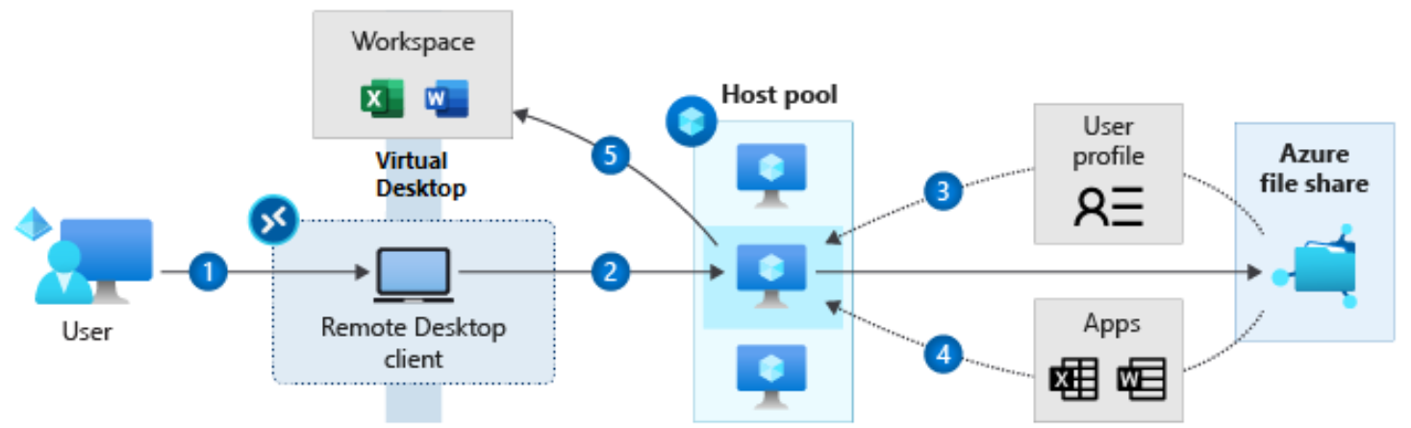
The process of accessing a user profile after signing into a RD client
User signs into the Remote Desktop client
User gets assigned to a session host virtual machine (VM)
VM gets the user profile from the Azure file share
If MSIX app attach configured, apps are dynamically delivered to the session host VM. MSIX app attach uses FSLogix storage concepts, but for applications
User gets their Azure Virtual Desktop workspace populated with their assigned app(s) or session desktop
Notes:
Azure Virtual Desktop service recommends FSLogix profile containers as a user profile solution. FSLogix is designed to roam profiles in remote computing environments, such as Azure Virtual Desktop. It stores a complete user profile in a single container.
At sign in, this container is dynamically attached to the computing environment using natively supported Virtual Hard Disk (VHD) and Hyper-V Virtual Hard disk (VHDX).
The VHD or VHDX files are stored to this location and attached to users the next time they sign in.
The following diagram shows the process of getting the user profile after a user signs into the Remote Desktop client.
User signs into the Remote Desktop client
User gets assigned to a session host virtual machine (VM)
VM gets the user profile from the Azure file share
(Preview) If you have MSIX app attach configured, apps are dynamically delivered to the session host VM. MSIX app attach uses FSLogix storage concepts, but for applications
User gets their Azure Virtual Desktop workspace populated with their assigned app(s) or session desktop
The user profile is immediately available and appears in the system exactly like a native user profile.

Slide 43
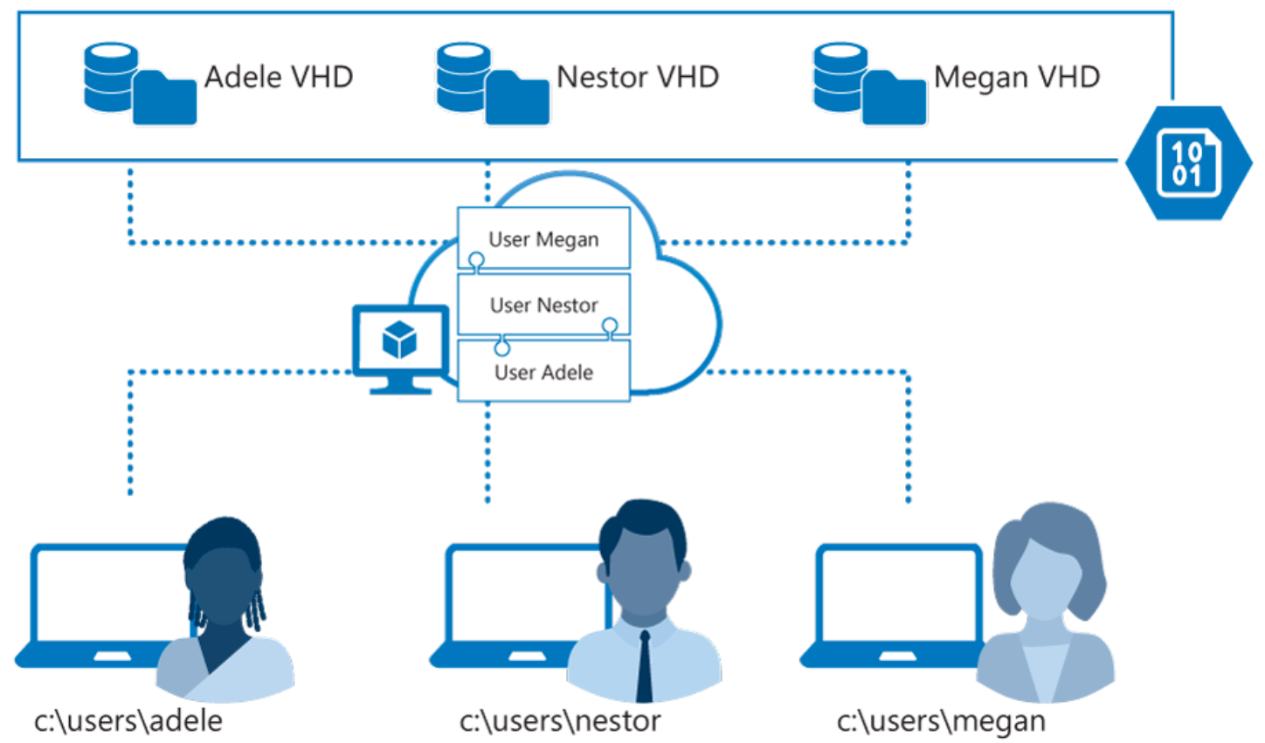
User Profiles and FSLogix components
FSLogix profile containers are the Azure Virtual Desktop user profile solution.
FSLogix is designed to roam profiles in remote computing environments.
It stores a complete user profile in a single container.
At sign in, this container is dynamically attached to the computing environment using natively supported VHD and VHDX.
The VHD or VHDX files are stored to this location and attached to users the next time they sign in.
Notes:
User profiles
A user profile contains data elements including desktop settings, persistent network connections, and application settings. By default, Windows creates a local user profile that is tightly integrated with the operating system.
A remote user profile provides a partition between user data and the operating system. It allows the operating system to be replaced or changed without affecting the user data. In Remote Desktop Session Host (RDSH) and Virtual Desktop Infrastructures (VDI), the operating system may be replaced for the following reasons:
An upgrade of the operating system
A replacement of an existing Virtual Machine (VM)
A user being part of a pooled (non-persistent) RDSH or VDI environment
Microsoft products operate with several technologies for remote user profiles, including these technologies:
Roaming user profiles (RUP)
User profile disks (UPD)
Enterprise state roaming (ESR)
UPD and RUP are the most widely used technologies for user profiles in Remote Desktop Session Host (RDSH) and Virtual Hard Disk (VHD) environments.

Slide 44
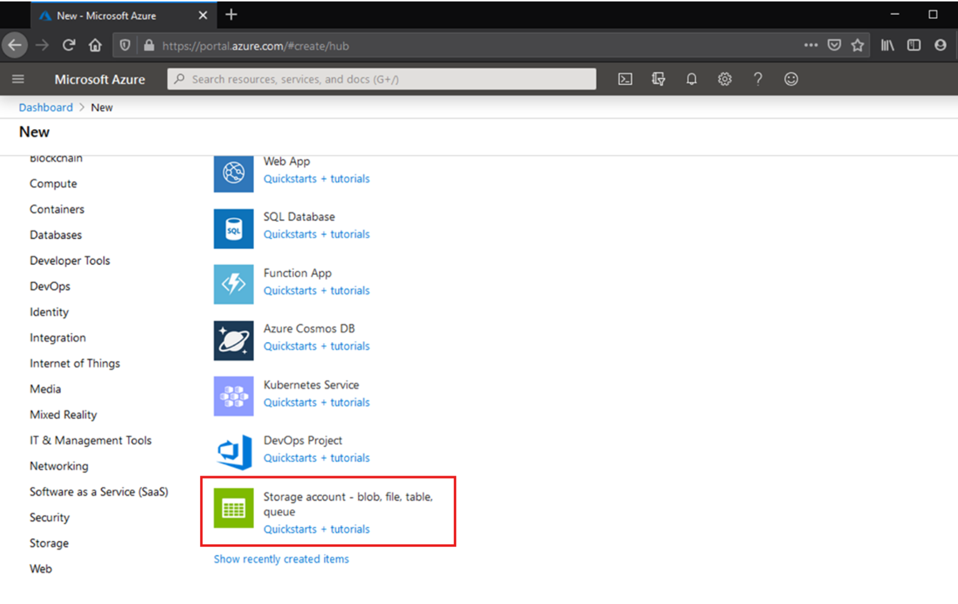
Azure supports multiple types of storage accounts for different storage scenarios
There are two main types of storage accounts for Azure Files.
General purpose version 2 (GPv2) storage accounts: Allow you to deploy Azure file shares on standard/hard disk-based (HDD-based) hardware.
In addition to storing Azure file shares, GPv2 storage accounts can store other storage resources such as blob containers, queues, or tables.
File shares can be deployed into the transaction optimized (default), hot, or cool tiers.
FileStorage storage accounts: FileStorage storage accounts allow you to deploy Azure file shares on premium/solid-state disk-based (SSD-based) hardware.
FileStorage accounts can only be used to store Azure file shares; no other storage resources (blob containers, queues, tables, etc.) can be deployed in a FileStorage account.
Notes:
There are two primary types of storage accounts for Azure Files. Which storage account type you need to create depends on whether you want to create a standard file share or a premium file share:
General purpose version 2 (GPv2) storage accounts: GPv2 storage accounts allow you to deploy Azure file shares on standard/hard disk-based (HDD-based) hardware. GPv2 storage accounts can store other storage resources such as blob containers, queues, or tables. File shares can be deployed into the transaction optimized (default), hot, or cool tiers.
FileStorage storage accounts: FileStorage storage accounts allow you to deploy Azure file shares on premium/solid-state disk-based (SSD-based) hardware. FileStorage accounts store Azure file shares. Storage resources, such as blob containers or queues, cannot be deployed in a FileStorage account.

Slide 45
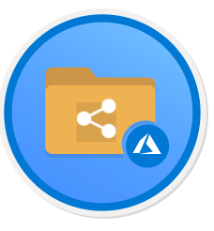
Once you've created a storage account, all that is left is to create your file share.
The process is the same for a premium file share or a standard file share.
You should consider the following differences:
Standard file shares may be deployed into one of the standard tiers:
transaction optimized (default)
Hot
Cool
This is a per file share tier that is not affected by the blob access tier of the storage account.
You can change the tier of the share at any time after it has been deployed.
Premium file shares cannot be directly converted to standard file shares in any standard tier.
You can move file shares between tiers within GPv2 storage account types (transaction optimized, hot, and cool).
Notes:
Once you've created a storage account, you can create a file share. Standard file shares may be deployed into one of the standard tiers: transaction optimized (default), hot, or cool. This is a per file share tier that is not affected by the blob access tier of the storage account.
You can change the tier of the share at any time after it has been deployed. Premium file shares cannot be directly converted to standard file shares in any standard tier.
You can move file shares between tiers within GPv2 storage account types (transaction optimized, hot, and cool).
quota means something slightly different between premium and standard file shares:
For standard file shares, it's an upper boundary of the Azure file share. The primary purpose for quota for a standard file share is budgetary: "I don't want this file share to grow beyond this point."
If a quota is not specified, standard file share can span up to 100 TiB.
For premium file shares, quota is overloaded to mean provisioned size. The provisioned size is the amount that you will be billed. Consider the following when configuring a premium file share:
The future growth of the share from a space utilization perspective
The IOPS required for your workload. Every provisioned GiB allows reserved and burst IOPS.

Slide 46
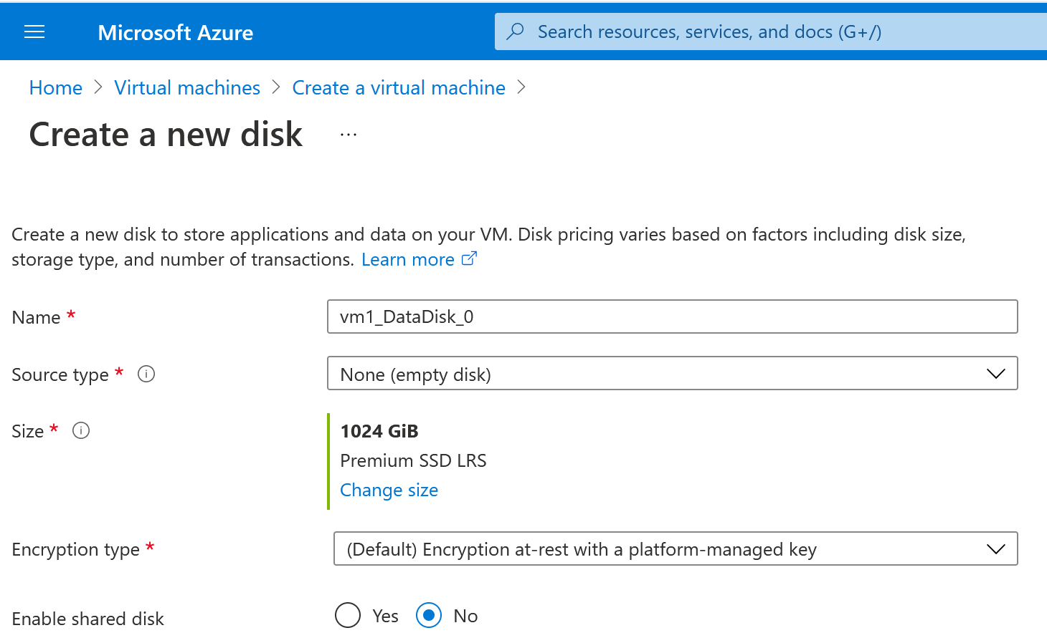
Add a data disk
Go to the Azure portal to add a data disk. Search for and select Virtual machines.
Select a virtual machine from the list.
On the Virtual machine page, select Disks.
On the Disks page, select Add data disk.
In the drop-down for the new disk, select Create disk.
In the Create managed disk page, type in a name for the disk and adjust the other settings as necessary. When you're done, select Create.
In the Disks page, select Save to save the new disk configuration for the VM.
After Azure creates the disk and attaches it to the virtual machine, the new disk is listed in the virtual machine's disk settings under Data disks.

Slide 47
To create the host pool, workspace, desktop app group, and register the desktop app group to the workspace, run:
New-AzWVDHostPool -ResourceGroupName <resourcegroupname> -Name <hostpoolname> -WorkspaceName <workspacename> -HostPoolType <Pooled|Personal> -LoadBalancerType <BreadthFirst|DepthFirst|Persistent> -Location <region> -DesktopAppGroupName <appgroupname>
To create a registration token to authorize a session host to join the host pool and save it to a new file on your local computer, run:
New-AzWVDRegistrationInfo -ResourceGroupName <resourcegroupname> -HostPoolName <hostpoolname> -ExpirationTime $((get-date).ToUniversalTime().AddDays(1).ToString('yyyy-MM-ddTHH:mm:ss.fffffffZ'))
To add Azure Active Directory users to the default desktop app group for the host pool, run:
New-AzRoleAssignment -SignInName <userupn> -RoleDefinitionName "Desktop Virtualization User" -ResourceName <hostpoolname+"-DAG"> -ResourceGroupName <resourcegroupname> -ResourceType 'Microsoft.DesktopVirtualization/applicationGroups'
To add Azure Active Directory user groups to the default desktop app group for the host pool, run:
New-AzRoleAssignment -ObjectId <usergroupobjectid> -RoleDefinitionName "Desktop Virtualization User" -ResourceName <hostpoolname+"-DAG"> -ResourceGroupName <resourcegroupname> -ResourceType 'Microsoft.DesktopVirtualization/applicationGroups'
Notes:
Create virtual machines for the host pool
After you have create an Azure virtual machine that can be joined to your Azure Virtual Desktop host pool.
You can create a virtual machine in multiple ways:
Create a virtual machine from an Azure Gallery image.
Create a virtual machine from a managed image.
Create a virtual machine from an unmanaged image.
Prepare the virtual machines for Azure Virtual Desktop agent installations
Do the following to prepare your virtual machines before you can install the Azure Virtual Desktop agents and register the virtual machines to your Azure Virtual Desktop host pool:
Domain join the virtual machine. This allows incoming Azure Virtual Desktop users to be mapped from their Azure Active Directory account to their Active Directory account and be successfully allowed access to the virtual machine.
Install the Remote Desktop Session Host (RDSH) role if the virtual machine is running a Windows Server OS. The RDSH role allows the Azure Virtual Desktop agents to install properly.

Slide 48
To configure a host pool to automatically assign users to VMs, run the following PowerShell cmdlet:
Update-AzWVDHostPool -ResourceGroupName <resourcegroupname> -Name <hostpoolname> -PersonalDesktopAssignmentType Automatic
To assign a user to the personal desktop host pool, run the following PowerShell cmdlet:
New-AzRoleAssignment -SignInName <userupn> -RoleDefinitionName "Desktop Virtualization User" -ResourceName <appgroupname> -ResourceGroupName <resourcegroupname> -ResourceType 'Microsoft.DesktopVirtualization/applicationGroups'
To configure a host pool to require direct assignment of users to session hosts, run this PowerShell cmdlet:
Update-AzWVDHostPool -ResourceGroupName <resourcegroupname> -Name <hostpoolname> -PersonalDesktopAssignmentType Direct
To assign a user to a specific session host, run the following PowerShell cmdlet:
Update-AzWvdSessionHost -HostPoolName <hostpoolname> -Name <sessionhostname> -ResourceGroupName <resourcegroupname> -AssignedUser <userupn>
Notes:
You can configure the assignment type of your personal desktop host pool to adjust your Azure Virtual Desktop environment to better suit your needs. In this unit, you'll see how to configure automatic or direct assignment for your users.
The instructions below apply to personal desktop host pools, not pooled host pools, since users in pooled host pools aren't assigned to specific session hosts. This applies to Azure Virtual Desktop with Azure Resource Manager Azure Virtual Desktop objects.

Slide 49
To add or edit a single custom RDP property, run:
Update-AzWVDHostPool -ResourceGroupName <resourcegroupname> -Name <hostpoolname> -CustomRdpProperty <property>
To add or edit multiple custom RDP properties, run the following by providing the custom RDP properties as a semicolon-separated string:
$properties="<property1>;<property2>;<property3>"
Update-AzWVDHostPool -ResourceGroupName <resourcegroupname> -Name <hostpoolname> -CustomRdpProperty $properties
You can check to make sure the RDP property was added by running:
Get-AzWVDHostPool -ResourceGroupName <resourcegroupname> -Name <hostpoolname> | format-list Name, CustomRdpProperty
Name : <hostpoolname>
CustomRdpProperty : <customRDPpropertystring>
Notes:
Customizing a host pool's Remote Desktop Protocol (RDP) properties, such as multi-monitor experience and audio redirection, lets you deliver an optimal experience for your users based on their needs.
You can customize RDP properties in Azure Virtual Desktop using the -CustomRdpProperty parameter in the Set-RdsHostPool cmdlet.

Slide 50
Azure Virtual Desktop licensing allows you to apply a license to any Windows or Windows Server virtual machine that is registered as a session host in a host pool and receives user connections.
Create
You can create a host pool and its session host virtual machines using the Azure Marketplace offering .
Virtual machines created this way automatically have the license applied.
Create
You can create a host pool and its session host virtual machines using the GitHub Azure Resource Manager template .
Virtual machines created this way automatically have the license applied.
Apply
You can apply a license to an existing session host virtual machine.
Apply a Windows license to a session host VM, run:
$vm = Get-AzVM -ResourceGroup <resourceGroupName> -Name <vmName>
$vm.LicenseType = "Windows_Client"
Update-AzVM -ResourceGroupName <resourceGroupName> -VM $vm
Notes:
Azure Virtual Desktop licensing allows you to apply a license to any Windows or Windows Server virtual machine that is registered as a session host in a host pool receiving user connections.
The license does not apply to virtual machines are running as file share servers or domain controllers.
There are a few ways to use the Azure Virtual Desktop license:
You can create a host pool and its session host virtual machines using the Azure Marketplace offering. Virtual machines created this way automatically have the license applied.
You can create a host pool and its session host virtual machines using the GitHub Azure Resource Manager template. Virtual machines created this way automatically have the license applied.
You can apply a license to an existing session host virtual machine. Follow the instructions in Create a host pool with PowerShell to create a host pool and associated virtual machines.

Slide 51
Azure AD-joined VMs eliminate line-of-sight from the VM to an on-premises Active Directory Domain Controller (DC) or deploying Azure AD Domain services (Azure AD DS).
The configurations supported with Azure AD-joined VMs:
Personal desktops with local user profiles.
Pooled desktops used as a jump box. In this configuration, users first access the Azure Virtual Desktop VM before connecting to a different PC on the network. Users shouldn't save data on the VM.
Pooled desktops or apps where users don't need to save data on the VM.
Access to on-premises or Active Directory domain-joined resources and should be considered when deciding whether Azure AD-joined VMs suits your environment.
Microsoft recommends Azure AD-joined VMs when users only need access to cloud-based resources or Azure AD-based authentication.
Notes:
This unit provides and overview for deploying and accessing Azure AD-joined virtual machines in Azure Virtual Desktop. Azure AD-joined virtual machines remove the need to have line-of-sight from the VM to an on-premises or virtualized Active Directory Domain Controller (DC) or to deploy Azure AD Domain Services (Azure AD DS). In some cases, it can remove the need for a DC entirely, simplifying the deployment and management of the environment. These virtual machines can also be automatically enrolled in Intune for ease of management.
The configurations listed below are supported with Azure AD-joined virtual machines:
Personal desktops with local user profiles.
Pooled desktops used as a jump box. In this configuration, users first access the Azure Virtual Desktop VM before connecting to a different PC on the network. Users shouldn't save data on the VM.
Pooled desktops or apps where users don't need to save data on the VM. For example, for applications that save data online or connect to a remote database.
User accounts can be cloud-only or hybrid users from the same Azure AD tenant.
Access to your on-premises or Active Directory domain-joined resources and should be considered when deciding whether Azure AD-joined virtual machines suits your environment. Microsoft recommends Azure AD-joined virtual machines for scenarios where users only need access to cloud-based resources or Azure AD-based authentication.
Azure Virtual Desktop (classic) doesn't support Azure AD-joined virtual machines.
Azure AD-joined virtual machines don't currently support external users.
Azure AD-joined virtual machines only supports local user profiles at this time.
Azure AD-joined virtual machines can't access Azure Files file shares for FSLogix or MSIX app attach. You'll need Kerberos authentication to access either of these features.
The Windows Store client doesn't currently support Azure AD-joined virtual machines.
Azure Virtual Desktop doesn't currently support single sign-on for Azure AD-joined virtual machines.

Slide 52
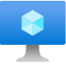
Create a managed VM image

Slide 53
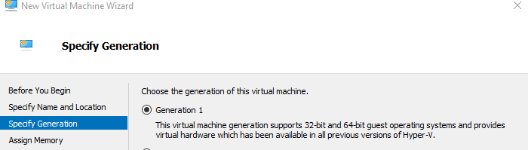
You can use an image from the Azure Image Gallery.
Local image creation
Windows 10 Enterprise multi-session is available in the Azure Image Gallery.
There are two options for customizing the image:
The first option is to provision a virtual machine (VM) in Azure
The second option is to create the image locally by downloading the image, provisioning a Hyper-V VM, and customizing it to suit your needs
Once you've downloaded the image to a local location, open Hyper-V Manager to create a VM with the VHD you copied. To create a VM with the copied VHD:
Open the New Virtual Machine Wizard.
On the Specify Generation page, select Generation 1.
Under Checkpoint Type, disable checkpoints by unchecking the check box.
Notes:
This unit shows you how to prepare a master virtual hard disk (VHD) image for upload to Azure including how to create virtual machines. These instructions are for an Azure Virtual Desktop-specific configuration that can be used with your organization's existing processes.
We recommend you use an image from the Azure Image Gallery. However, if you do need to use a customized image, make sure you don't already have the Azure Virtual Desktop Agent installed on your device. Using a customized image with the Azure Virtual Desktop Agent can cause problems with the image.
Create a virtual machine
Windows 10 Enterprise multi-session is available in the Azure Image Gallery. There are two options for customizing this image.
The first option is to provision a virtual machine in Azure (See: Create a virtual machine from a managed image).
The second option is to create the image locally by downloading the image, provisioning a Hyper-V virtual machine, and customizing it to suit your needs.
Create a virtual machine from a managed image
You can create multiple virtual machines from an Azure managed virtual machine image using the Azure portal or PowerShell. A managed virtual machine image contains the information necessary to create a virtual machine, including the OS and data disks. The virtual hard disks (VHDs) that make up the image, including both the OS disks and any data disks, are stored as managed disks.
Before creating a new virtual machine, create a managed virtual machine image to use as the source image and grant read access on the image to any user who should have access to the image.
One managed image supports up to 20 simultaneous deployments. Attempting to create more than 20 virtual machines concurrently, from the same managed image, may result in provisioning timeouts due to the storage performance limitations of a single VHD. To create more than 20 virtual machines concurrently, use a Shared Image Galleries image configured with 1 replica for every 20 concurrent virtual machine deployments.

Slide 54
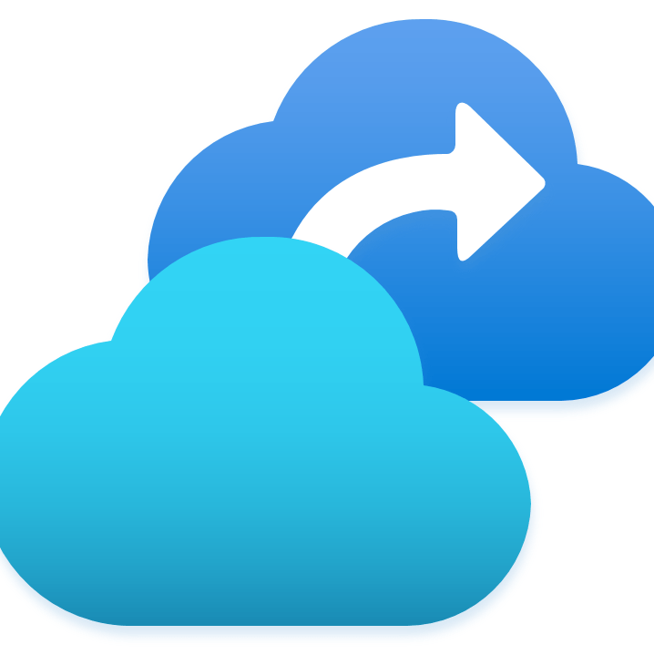
Modify a session host image

Slide 55
To disable Automatic Updates via local Group Policy, run:
reg add "HKLM\SOFTWARE\Policies\Microsoft\Windows\WindowsUpdate\AU" /v NoAutoUpdate /t REG_DWORD /d 1 /f
Run this command to specify a Start layout for Windows 10 PCs, run:
reg add "HKLM\SOFTWARE\Microsoft\Windows\CurrentVersion\Explorer" /v SpecialRoamingOverrideAllowed /t REG_DWORD /d 1 /f
To redirect time zones, run this command on the master image:
reg add "HKLM\SOFTWARE\Policies\Microsoft\Windows NT\Terminal Services" /v fEnableTimeZoneRedirection /t REG_DWORD /d 1 /f

Slide 56
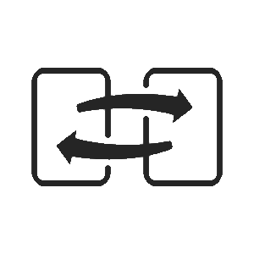
Plan for image update and management

Slide 57
Plan for image update and management
If you have many images that you need to maintain and would like to make them available throughout your company, you can use a Shared Image Gallery as a repository.
The Shared Image Gallery feature has multiple resource types:
Resource | Description
Image source | This is a resource that can be used to create an image version in an image gallery. An image source can be an existing Azure VM that is either generalized or specialized, a managed image, a snapshot, a VHD or an image version in another image gallery.
Image gallery | Like the Azure Marketplace, an image gallery is a repository for managing and sharing images, but you control who has access.
Image definition | Image definitions are created within a gallery and carry information about the image and requirements for using it internally. This includes whether the image is Windows or Linux, release notes, and minimum and maximum memory requirements. It is a definition of a type of image.
Image version | An image version is what you use to create a VM when using a gallery. You can have multiple versions of an image as needed for your environment. Like a managed image, when you use an image version to create a VM, the image version is used to create new disks for the VM. Image versions can be used multiple times.
Notes:
Make your images highly available
Azure Zone Redundant Storage (ZRS) provides resilience against an Availability Zone failure in the region. With the general availability of Shared Image Gallery, you can choose to store your images in ZRS accounts in regions with Availability Zones.
You can also choose the account type for each of the target regions. The default storage account type is Standard_LRS, but you can choose Standard_ZRS for regions with Availability Zones. Check the regional availability of ZRS here.
Replication
Shared Image Gallery also allows you to replicate your images to other Azure regions automatically. Each Shared Image version can be replicated to different regions depending on what makes sense for your organization. One example is to always replicate the latest image in multi-regions while all older versions are only available in one region to save on storage costs for Shared Image versions.
The regions a Shared Image version is replicated to can be updated after creation time. The time it takes to replicate to different regions depends on the amount of data being copied and the number of regions the version is replicated to. While the replication is happening, you can view the status of replication per region. Once the image replication is complete in a region, you can then deploy a VM or scale-set using that image version in the region.
Access
The Shared Image Gallery, Image Definition, and Image version are resources that are shared using the built-in native Azure role-based access control (RBAC) controls. Using Azure role-based access control (RBAC) you can share these resources to other users, service principals, and groups. You can even share access to individuals outside of the tenant they were created within. Once a user has access to the Shared Image version, they can deploy a VM or a Virtual Machine Scale Set.

Slide 58
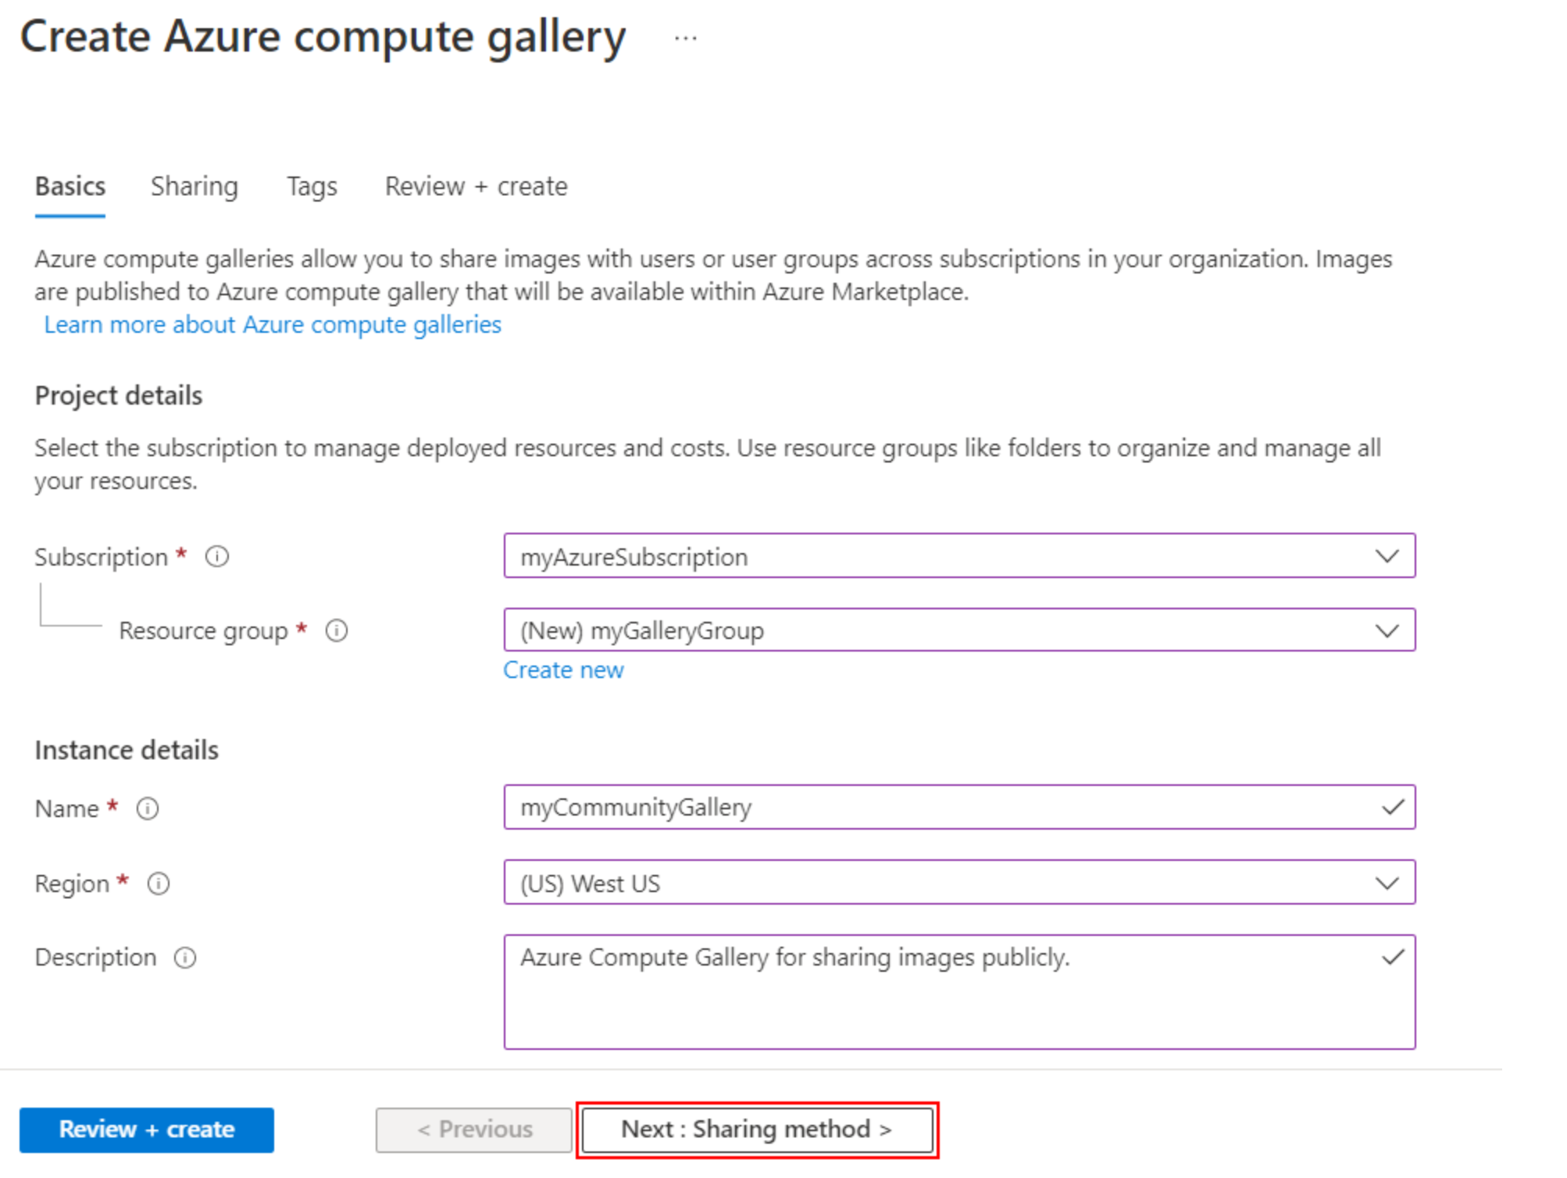
An Azure Compute Gallery simplifies sharing resources, like images and application packages, across your organization.
The Azure Compute Gallery lets you share custom VM images and application packages with others in your organization.
Choose what you want to share, which regions you want to make them available in, and who you want to share them with.
You can create multiple galleries so that you can logically group resources.
Notes:
Create a private gallery
Sign in to the Azure portal at https://portal.azure.com.
Type Azure Compute Gallery in the search box and select Azure Compute Gallery in the results.
In the Azure Compute Gallery page, click Add.
On the Create Azure Compute Gallery page, select the correct subscription.
In Resource group, select a resource group from the drop-down or select Create new and type a name for the new resource group.
In Name, type a name for the name of the gallery.
Select a Region from the drop-down.
You can type a short description of the gallery, like My gallery for testing. and then click Review + create.
After validation passes, select Create.
When the deployment is finished, select Go to resource.
Create a direct shared gallery
Sign in to the Azure portal at https://portal.azure.com.
Type Azure Compute Gallery in the search box and select Azure Compute Gallery in the results.
In the Azure Compute Gallery page, click Add.
On the Create Azure Compute Gallery page, select the correct subscription.
Complete all of the details on the page.
At the bottom of the page, select Next: Sharing method.
On the Sharing tab, select RBAC + share directly.
When you're done, select Review + create.
After validation passes, select Create.
When the deployment is finished, select Go to resource.

Slide 59

Create an Azure Virtual Desktop image by using VM Image Builder

Slide 60
You can distribute the image to an Azure Compute Gallery, where you can replicate it to other regions, control the scale, and share the image within and beyond your organization.
You can create an Azure Virtual Desktop image with these customizations:
FSLogix setup
Azure Virtual Desktop optimization
Microsoft Teams installation
Windows Restart customizer
Windows Update customizer
To build the image, run the scripts below.
Start-AzImageBuilderTemplate -ResourceGroupName $imageResourceGroup -Name $imageTemplateName -NoWait

Slide 61
Install Microsoft 365 Apps on a master Virtual Hard Disk image

Slide 62
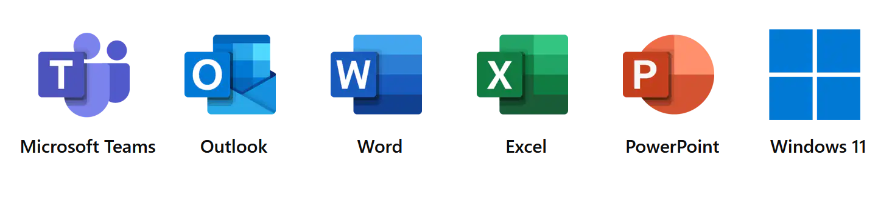
You can install Microsoft 365 Apps for enterprise, OneDrive, and other common applications on a master virtual hard disk (VHD) image for upload to Azure.
Shared computer activation allows deployment of Microsoft 365 Apps for enterprise to a computer that is accessed by multiple users.
Use the Office Deployment Tool to install Office.
Windows 10 Enterprise multi-session only supports the following versions of Office:
Microsoft 365 Apps for enterprise
Microsoft 365 Apps for business that comes with a Microsoft 365 Business Premium subscription

Slide 63
Install language packs in Azure Virtual Desktop

Slide 64
You need the following to customize a Windows 10 Enterprise multi-session images for adding multiple languages:
An Azure virtual machine (VM) with Windows 10 Enterprise multi-session.
The Language ISO, Feature on Demand (FOD) Disk 1, and Inbox Apps ISO of the OS version the image uses.
An Azure Files Share or a file share on a Windows File Server Virtual Machine
To create a custom Windows 10 Enterprise multi-session image manually:
Deploy an Azure VM, then go to the Azure Gallery and select the current version of Windows 10 Enterprise multi-session you're using.
After you've deployed the VM, connect to it using RDP as a local admin.
Make sure your VM has all the latest Windows Updates.
Connect to the language package, FOD, and Inbox Apps file share repository and mount it to a letter drive (for example, drive E).
Notes:
You want your users be able to customize which language their Windows 10 Enterprise multi-session image displays.
There are two ways you can accommodate the language needs of your users:
Build dedicated host pools with a customized image for each language.
Have users with different language and localization requirements in the same host pool, but customize their images to ensure they can select whichever language they need.
The latter method is a lot more efficient and cost-effective. However, it's up to you to decide which method best suits your needs.
This unit will show you how to customize languages for your images.
You need the following to customize Windows 10 Enterprise multi-session images to add multiple languages:
An Azure virtual machine (VM) with Windows 10 Enterprise multi-session.
The Language ISO, Feature on Demand (FOD) Disk 1, and Inbox Apps ISO of the OS version the image uses.
An Azure Files Share or a file share on a Windows File Server Virtual Machine
The file share (repository) must be accessible from the Azure VM you plan to use to create the custom image.
Create a custom Windows 10 Enterprise multi-session image manually
To create a custom Windows 10 Enterprise multi-session image manually:
Deploy an Azure VM, then go to the Azure Gallery and select the current version of Windows 10 Enterprise multi-session you're using.
After you've deployed the VM, connect to it using RDP as a local admin.
Make sure your VM has all the latest Windows Updates. Download the updates and restart the VM, if necessary.
Connect to the language package, FOD, and Inbox Apps file share repository and mount it to a letter drive (for example, drive E).
Finish customizing your image
After you've installed the language packs, you can install any other software you want to add to your customized image.
Once you're finished customizing your image, you'll need to run the system preparation tool (sysprep).
To run sysprep:
Open an elevated command prompt and run the following command to generalize the image:
C:\Windows\System32\Sysprep\sysprep.exe /oobe /generalize /shutdown Stop the VM, then capture it in a managed.
You can now use the customized image to deploy an Azure Virtual Desktop host pool.

Slide 65
RBAC for Azure Virtual Desktop
Desktop Virtualization Contributor
The Desktop Virtualization Contributor role lets you manage all aspects of the deployment.
Desktop Virtualization Reader
The Desktop Virtualization Reader role lets you view everything in the deployment but doesn't let you make any changes.
Host Pool Contributor
The Host Pool Contributor role lets you manage all aspects of host pools, including access to resources.
Host Pool Reader
The Host Pool Reader role lets you view everything in the host pool but won't allow you to make any changes.
Application Group Contributor
The Application Group Contributor role lets you manage all aspects of app groups.
Application Group Reader
The Application Group Reader role lets you view everything in the app group and will not allow you to make any changes.
Workspace Contributor
The Workspace Contributor role lets you manage all aspects of workspaces.
Workspace Reader
The Workspace Reader role lets you view everything in the workspace but won't allow you to make any changes.
User Session Operator
The User Session Operator role lets you send messages, disconnect sessions, and use the "logoff" function to sign sessions out of the session host.
Session Host Operator
The Session Host Contributor role lets you view and remove session hosts, as well as change drain mode.
Notes:
Azure Virtual Desktop uses Azure role-based access controls (RBAC) to assign roles to users and admins. These roles give admins permission to carry out certain tasks.
The standard built-in roles for Azure are:
Owner
Contributor
Reader
However, Azure Virtual Desktop has additional roles that let you separate management roles for host pools, app groups, and workspaces.
These roles are named in compliance with Azure's standard roles and least-privilege methodology.
Azure Virtual Desktop doesn't have a specific Owner role. However, you can use a standard Owner role for the service objects.

Slide 66
Security principal
Users
User groups
Service principals
Role definition
Built-in roles
Custom roles
Scope
Host pools
App groups
Workspaces
To add Azure Active Directory users to an app group, run:
New-AzRoleAssignment -SignInName <userupn> -RoleDefinitionName "Desktop Virtualization User" -ResourceName <appgroupname> -ResourceGroupName <resourcegroupname> -ResourceType 'Microsoft.DesktopVirtualization/applicationGroups'
To add Azure Active Directory user group to an app group, run:
New-AzRoleAssignment -ObjectId <usergroupobjectid> -RoleDefinitionName "Desktop Virtualization User" -ResourceName <appgroupname> -ResourceGroupName <resourcegroupname> -ResourceType 'Microsoft.DesktopVirtualization/applicationGroups'
Notes:
Azure Virtual Desktop has a delegated access model that lets you define the amount of access a particular user is allowed to have by assigning them a role.
A role assignment has three components: security principal, role definition, and scope.
The Azure Virtual Desktop delegated access model is based on the Azure role-based access control (RBAC) model.
Azure Virtual Desktop delegated access supports the following values for each element of the role assignment:
Security principal
Users
User groups
Service principals
Role definition
Built-in roles
Custom roles
Scope
Host pools
App groups
Workspaces

Slide 67
Screen capture protection for Azure Virtual Desktop
Screen capture protection prevents sensitive information from being captured at client endpoints.
When enabled, the remote content will be automatically blocked or hidden in screenshots and screen shares.
The Remote Desktop client hides content from malicious software attempting to capture the screen.
Notes:
The screen capture protection feature prevents sensitive information from being captured on the client endpoints. When you enable this feature, remote content will be automatically blocked or hidden in screenshots and screen shares. Also, the Remote Desktop client will hide content from malicious software that may be capturing the screen.
Screen capture protection is configured on the session host level and enforced on the client. Only clients that support this feature can connect to the remote session.
Following clients currently support screen capture protection:
Windows Desktop client supports screen capture protection for full desktops only.
macOS client version 10.7.0 or older supports screen capture protection for both RemoteApp and full desktops.

Slide 68
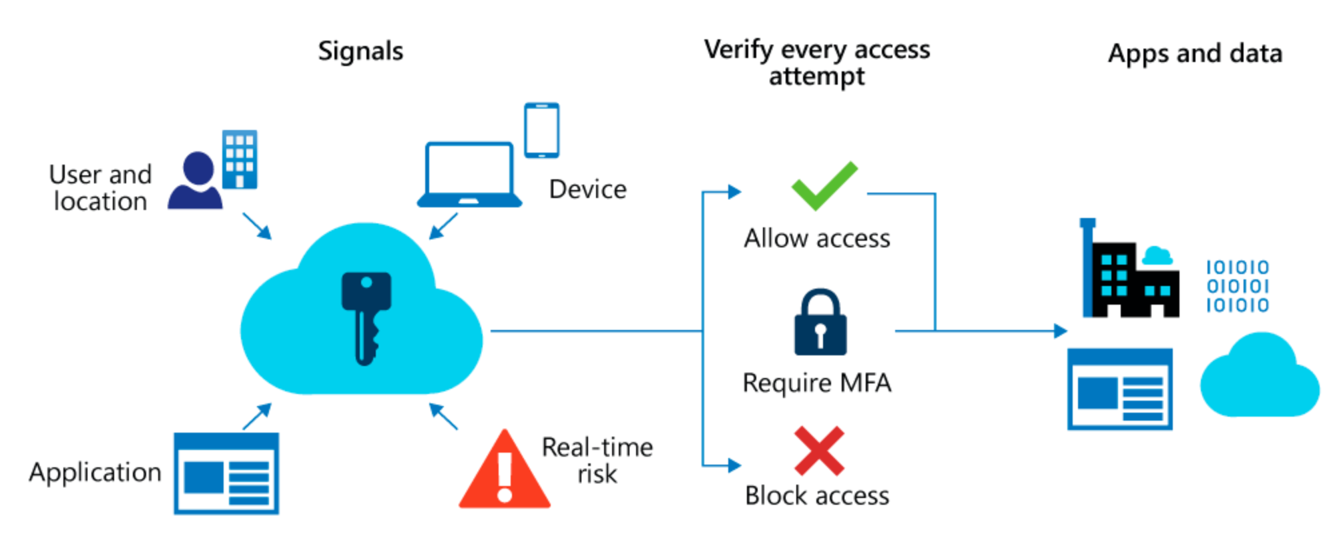
Azure Active Directory (Azure AD) Conditional Access analyses signals to automate decisions and enforce organizational access policies for resource.
Conditional Access policies to apply access controls like multifactor authentication (MFA).
Conditional Access policies allow you to prompt users for MFA when needed.
Notes:
Planning your Conditional Access deployment is critical to achieving your organization's access strategy for apps and resources.
Azure Active Directory (Azure AD) Conditional Access analyses signals such as user, device, and location to automate decisions and enforce organizational access policies for resource. You can use Conditional Access policies to apply access controls like multifactor authentication (MFA). Conditional Access policies allow you to prompt users for MFA when needed for security, and stay out of users’ way when not needed.

Slide 69
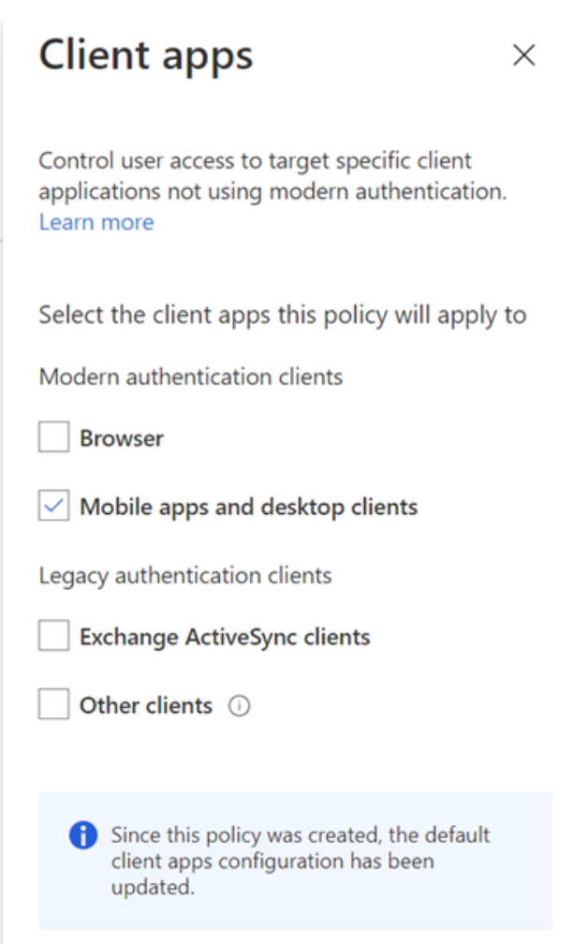
Plan MFA in Azure Virtual Desktop
When you first sign in, the client asks for your username, password, and Azure multifactor authentication.
The next time you sign in, the client will remember your token from your Azure Active Directory (AD) Enterprise Application.
When you select Remember me on the prompt for credentials for the session host, your users can sign in after restarting the client without needing to reenter their credentials.
Notes:
The Windows client for Azure Virtual Desktop integrates Azure Virtual Desktop with your local machine. However, when you configure your Azure Virtual Desktop account into the Windows client, there are certain actions you'll need to take to keep your users safe.
When you first sign in, the client asks for your username, password, and Azure Active Directory Multi-Factor Authentication. The next time you sign in, the client will remember your token from your Azure Active Directory (AD) Enterprise Application.
When they select Remember me on the prompt for credentials for the session host, your users can sign in after restarting the client without needing to reenter their credentials.
While remembering credentials is convenient, it can also make deployments on Enterprise scenarios or personal devices less secure. To protect your users, you can make sure the client keeps asking for Azure Active Directory Multi-Factor Authentication credentials more frequently.

Slide 70
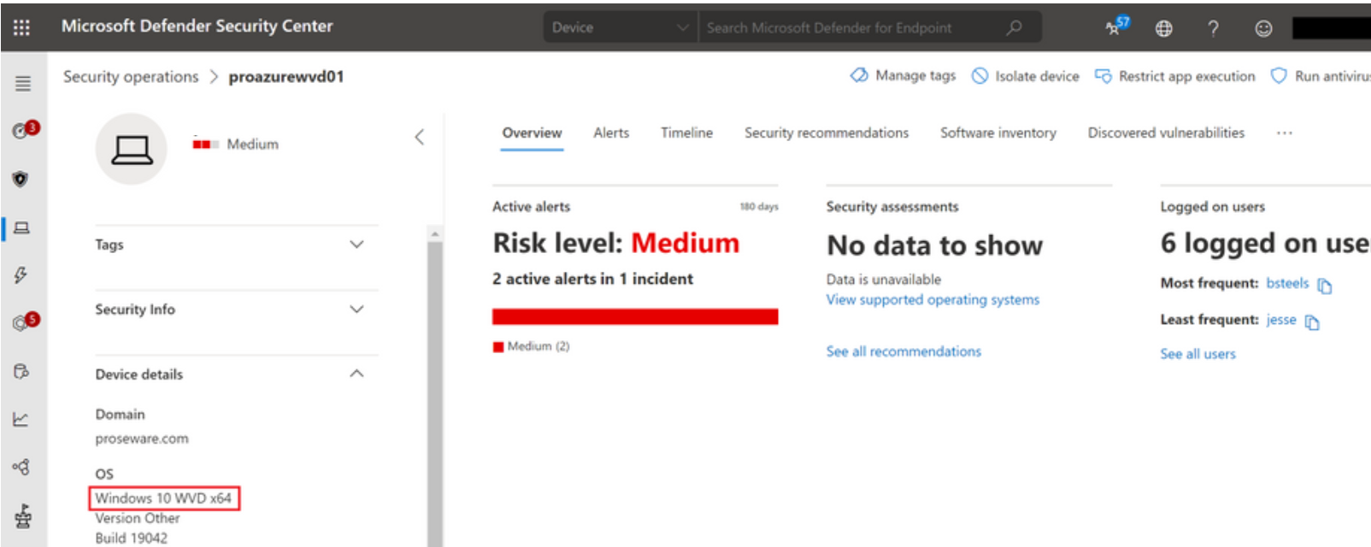
Microsoft Defender Antivirus for session hosts
Works with virtual desktops running in Azure Virtual Desktop in Azure or on a physical Windows 10 Endpoint.
Supports Azure Virtual Desktop with up to 50 concurrent user connections for Windows 10 Enterprise multi-session.
Single session scenarios on Windows 10 Enterprise is supported for onboarding Azure Virtual Desktop machines into Defender for Endpoint.
Notes:
Microsoft Defender for Endpoint is an enterprise endpoint security platform to help businesses prevent, investigate, detect, and respond to threats. Microsoft Defender for Endpoint increases endpoint security for Azure Virtual Desktop and Windows 10 physical endpoints.
Defender for Endpoint allows up to 50 concurrent user connections for Windows 10 Enterprise multi-session running on Azure Virtual Desktop.
Single session scenarios on Windows 10 Enterprise are fully supported for onboarding your Azure Virtual Desktop machines into Defender for Endpoint.

Slide 71
Monitor and maintain AVD

Slide 72
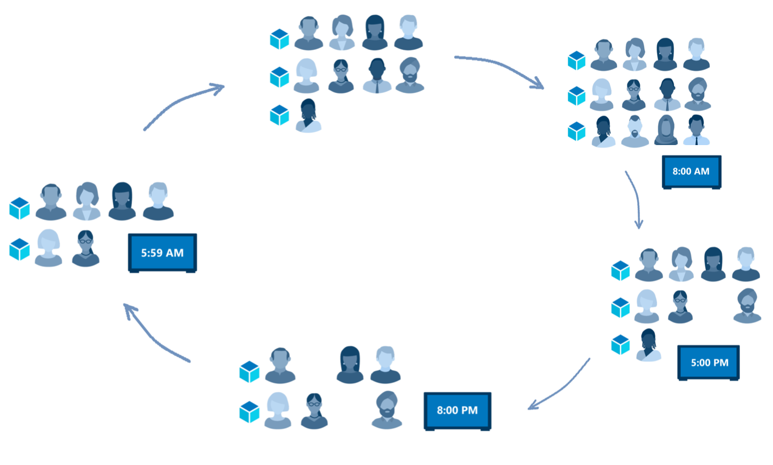
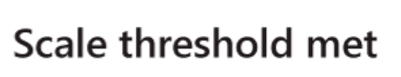
Scale session hosts using Azure Automation
Notes:
You can reduce your total Azure Virtual Desktop deployment cost by scaling your virtual machines. This means shutting down and deallocating session host VMs during off-peak usage hours, then turning them back on and reallocating them during peak hours.
As seen in graphic:
Early morning, employees arriving at work (5:59am) -> The scale threshold is met, increased VM allocation to meet demand -> Ideal optimization for VM allocation (8:00am) -> Workday winding down (5:00pm) -> Remaining workers begin leaving for home (8:00am)
How the scaling tool works
The scaling tool provides a low-cost automation option for customers who want to optimize their session host VM costs.
You can use the scaling tool to:
Schedule VMs to start and stop based on Peak and Off-Peak business hours.
Scale out VMs based on number of sessions per CPU core.
Scale in VMs during Off-Peak hours, leaving the minimum number of session host VMs running.
The scaling tool uses a combination of an Azure Automation account, a PowerShell runbook, a webhook, and the Azure Logic App to function. When the tool runs, Azure Logic App calls a webhook to start the Azure Automation runbook. The runbook then creates a job.
During peak usage time, the job checks the current number of sessions and the VM capacity of the current running session host for each host pool.
If the session host VMs can't support existing sessions, the job starts additional session host VMs in the host pool.
During the off-peak usage time, the job determines how many session host VMs should be shut down. The job will set the session host VMs to drain mode to prevent new sessions from connecting to the hosts.
The job will notify any currently signed in users to save their work, wait the configured amount of time, and then force the users to sign out.
Once all user sessions on the session host VM have been signed out, the job will shut down the VM.
After the VM shuts down, the job will reset its session host drain mode.

Slide 73
Create or update an Azure Automation account
To download the script for creating the Azure Automation account, run:
New-Item -ItemType Directory -Path "C:\Temp" -Force
Set-Location -Path "C:\Temp"
$Uri = "https://raw.githubusercontent.com/Azure/RDS-Templates/master/AVD-templates/AVD-scaling-script/CreateOrUpdateAzAutoAccount.ps1"
# Download the script
Invoke-WebRequest -Uri $Uri -OutFile ".\CreateOrUpdateAzAutoAccount.ps1"
To execute the script and create the Azure Automation account, run:
$Params = @{
"AADTenantId" = "<Azure_Active_Directory_tenant_ID>" # Optional. If not specified, it will use the current Azure context
"SubscriptionId" = "<Azure_subscription_ID>" # Optional. If not specified, it will use the current Azure context
"UseARMAPI" = $true
"ResourceGroupName" = "<Resource_group_name>" # Optional. Default: "AVDAutoScaleResourceGroup"
"AutomationAccountName" = "<Automation_account_name>" # Optional. Default: "AVDAutoScaleAutomationAccount"
"Location" = "<Azure_region_for_deployment>"
"WorkspaceName" = "<Log_analytics_workspace_name>" # Optional. If specified, Log Analytics will be used to configure the custom log table that the runbook PowerShell script can send logs to
}
.\CreateOrUpdateAzAutoAccount.ps1 @Params
Note: To setup a standalone automation account and Run As account using the Azure portal, see Create a standalone Azure Automation account.
Notes:
You'll need an Azure Automation account to run the PowerShell runbook. The process this section describes is useful even if you have an existing Azure Automation account that you want to use to set up the PowerShell runbook.

Slide 74
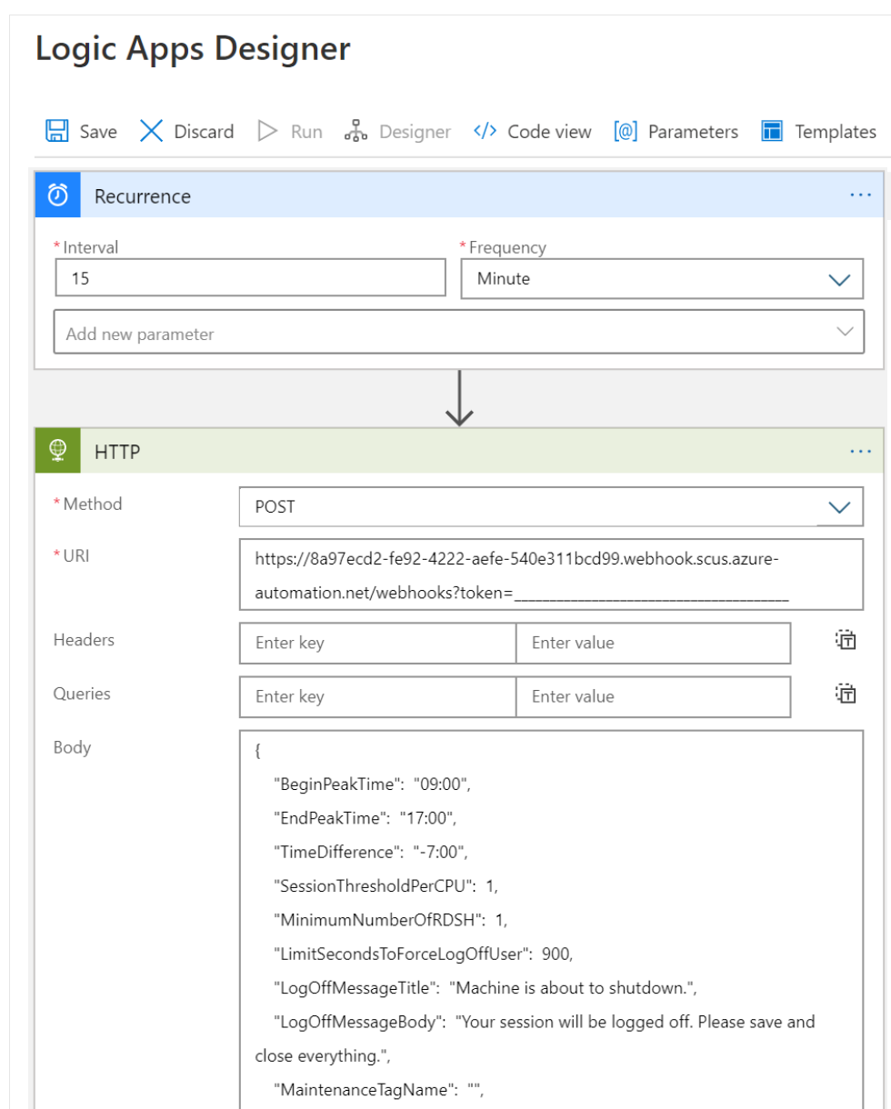
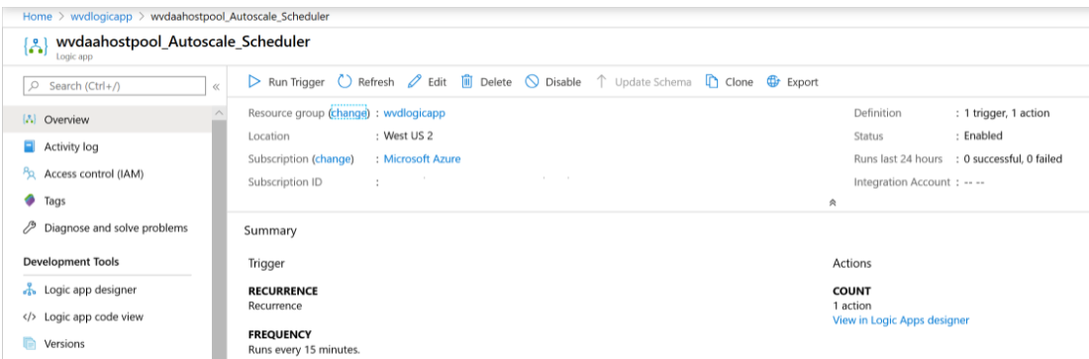
Create the Azure Logic App and execution schedule
Create the Azure Logic App and set up an execution schedule for your new scaling tool.
1. To create the Azure Logic App and execution schedule for a host pool using PowerShell, run the script located at Create the Azure Logic App and execution schedule.
2. To make changes to the execution schedule, open the Logic App and use the Logic Apps Designer.
Notes:
Procedure: Scale session hosts Azure Automation Azure Virtual Desktop (classic) - Azure | Microsoft Docs
You can reduce your total Azure Virtual Desktop deployment cost by scaling your virtual machines (VMs). This means shutting down and deallocating session host VMs during off-peak usage hours, then turning them back on and reallocating them during peak hours.
The scaling tool built with the Azure Automation account and Azure Logic App automatically scales session host VMs in your Azure Virtual Desktop environment.
To make changes to the execution schedule, such as changing the recurrence interval or time zone, go to the Azure Logic App autoscale scheduler and select Edit to go to the Azure Logic App Designer.
Progression:
Create an Azure Automation account
Create an Azure Automation Run As account
Create the Azure Logic App and execution schedule
When the tool runs, Azure Logic App calls a webhook to start the Azure Automation runbook. The runbook then creates a job.

Slide 75
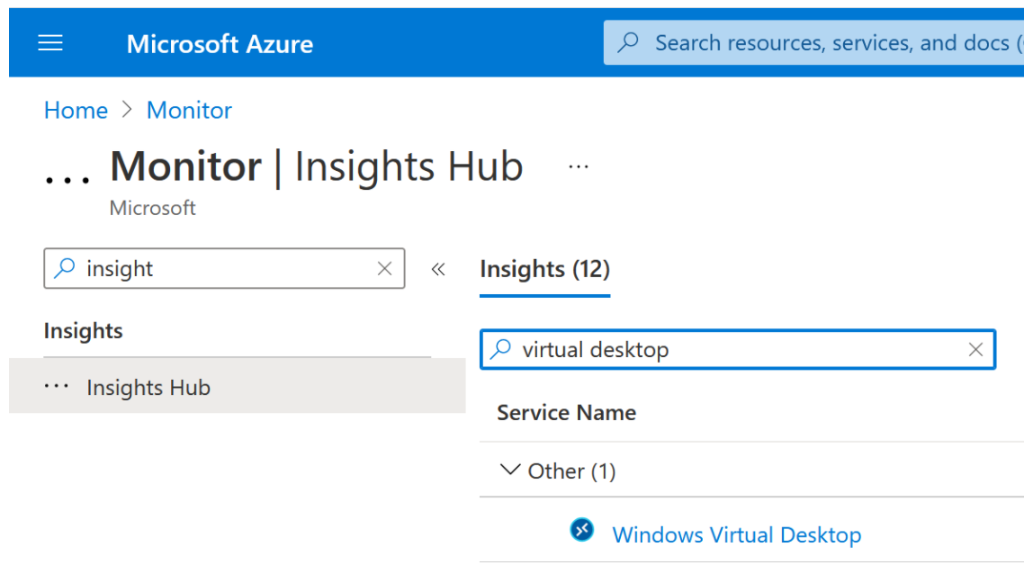
Monitor Azure Virtual Desktop by using Azure Monitor
You can open Azure Monitor for Azure Virtual Desktop by doing the following:
Go to the Azure portal.
Search for and select Monitor from the Azure portal. Select Insights Hub under Insights, then select Azure Virtual Desktop.
Once you have the page open, enter the Subscription, Resource group, Host pool, and Time range of the environment you want to monitor.
Notes:
Before you start using Azure Monitor for Azure Virtual Desktop, you'll need to set up the following things:
At least one configured Log Analytics Workspace. Use a designated Log Analytics workspace for your Azure Virtual Desktop session hosts to ensure that performance counters and events are only collected from session hosts in your Azure Virtual Desktop deployment.
Enable data collection for the following things in your Log Analytics workspace:
Diagnostics from your Azure Virtual Desktop environment
Recommended performance counters from your Azure Virtual Desktop session hosts
Recommended Windows Event Logs from your Azure Virtual Desktop session hosts
You can open Azure Monitor for Azure Virtual Desktop by doing the following:
Go to the Azure portal.
Search for and select Azure Monitor from the Azure portal.
Select Insights Hub under Insights, then select Azure Virtual Desktop.
Once you have the page open, enter the Subscription, Resource group, Host pool, and Time range of the environment you want to monitor.

Slide 76
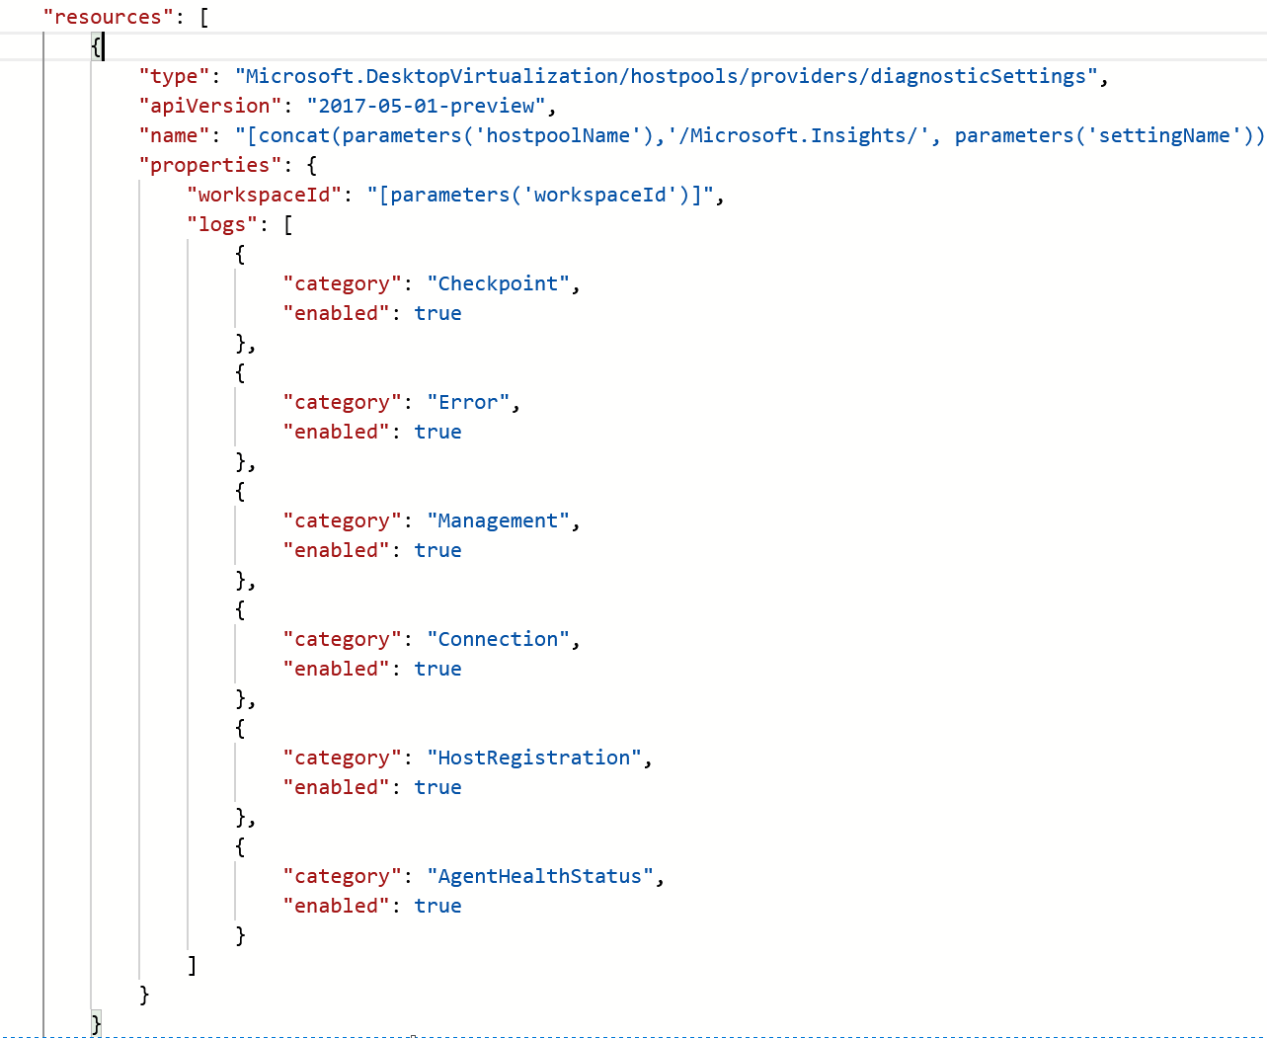
Log Analytics workspace for Azure Monitor
To set up host pool diagnostics using the resource diagnostic settings section in the configuration workbook:
You need to enable the following supported diagnostic tables:
Checkpoint
Error
Management
Connection
HostRegistration
AgentHealthStatus
Notes:
To start using Azure Monitor for Azure Virtual Desktop, you'll need at least one Log Analytics workspace. Use a designated Log Analytics workspace for your Azure Virtual Desktop session hosts to ensure that performance counters and events are only collected form session hosts in your Azure Virtual Desktop deployment.
If it's your first time opening Azure Monitor for Azure Virtual Desktop, you'll need set up Azure Monitor for your Azure Virtual Desktop environment. To configure your resources:
Open Azure Monitor for Azure Virtual Desktop in the Azure portal at aka.ms/azmonwvdi, then select configuration workbook.
Select an environment to configure under Subscription, Resource Group, and Host Pool.
The configuration workbook sets up your monitoring environment and lets you check the configuration after you've finished the setup process. It's important to check your configuration if items in the dashboard aren't displaying correctly, or when the product group publishes updates that require new settings.

Slide 77
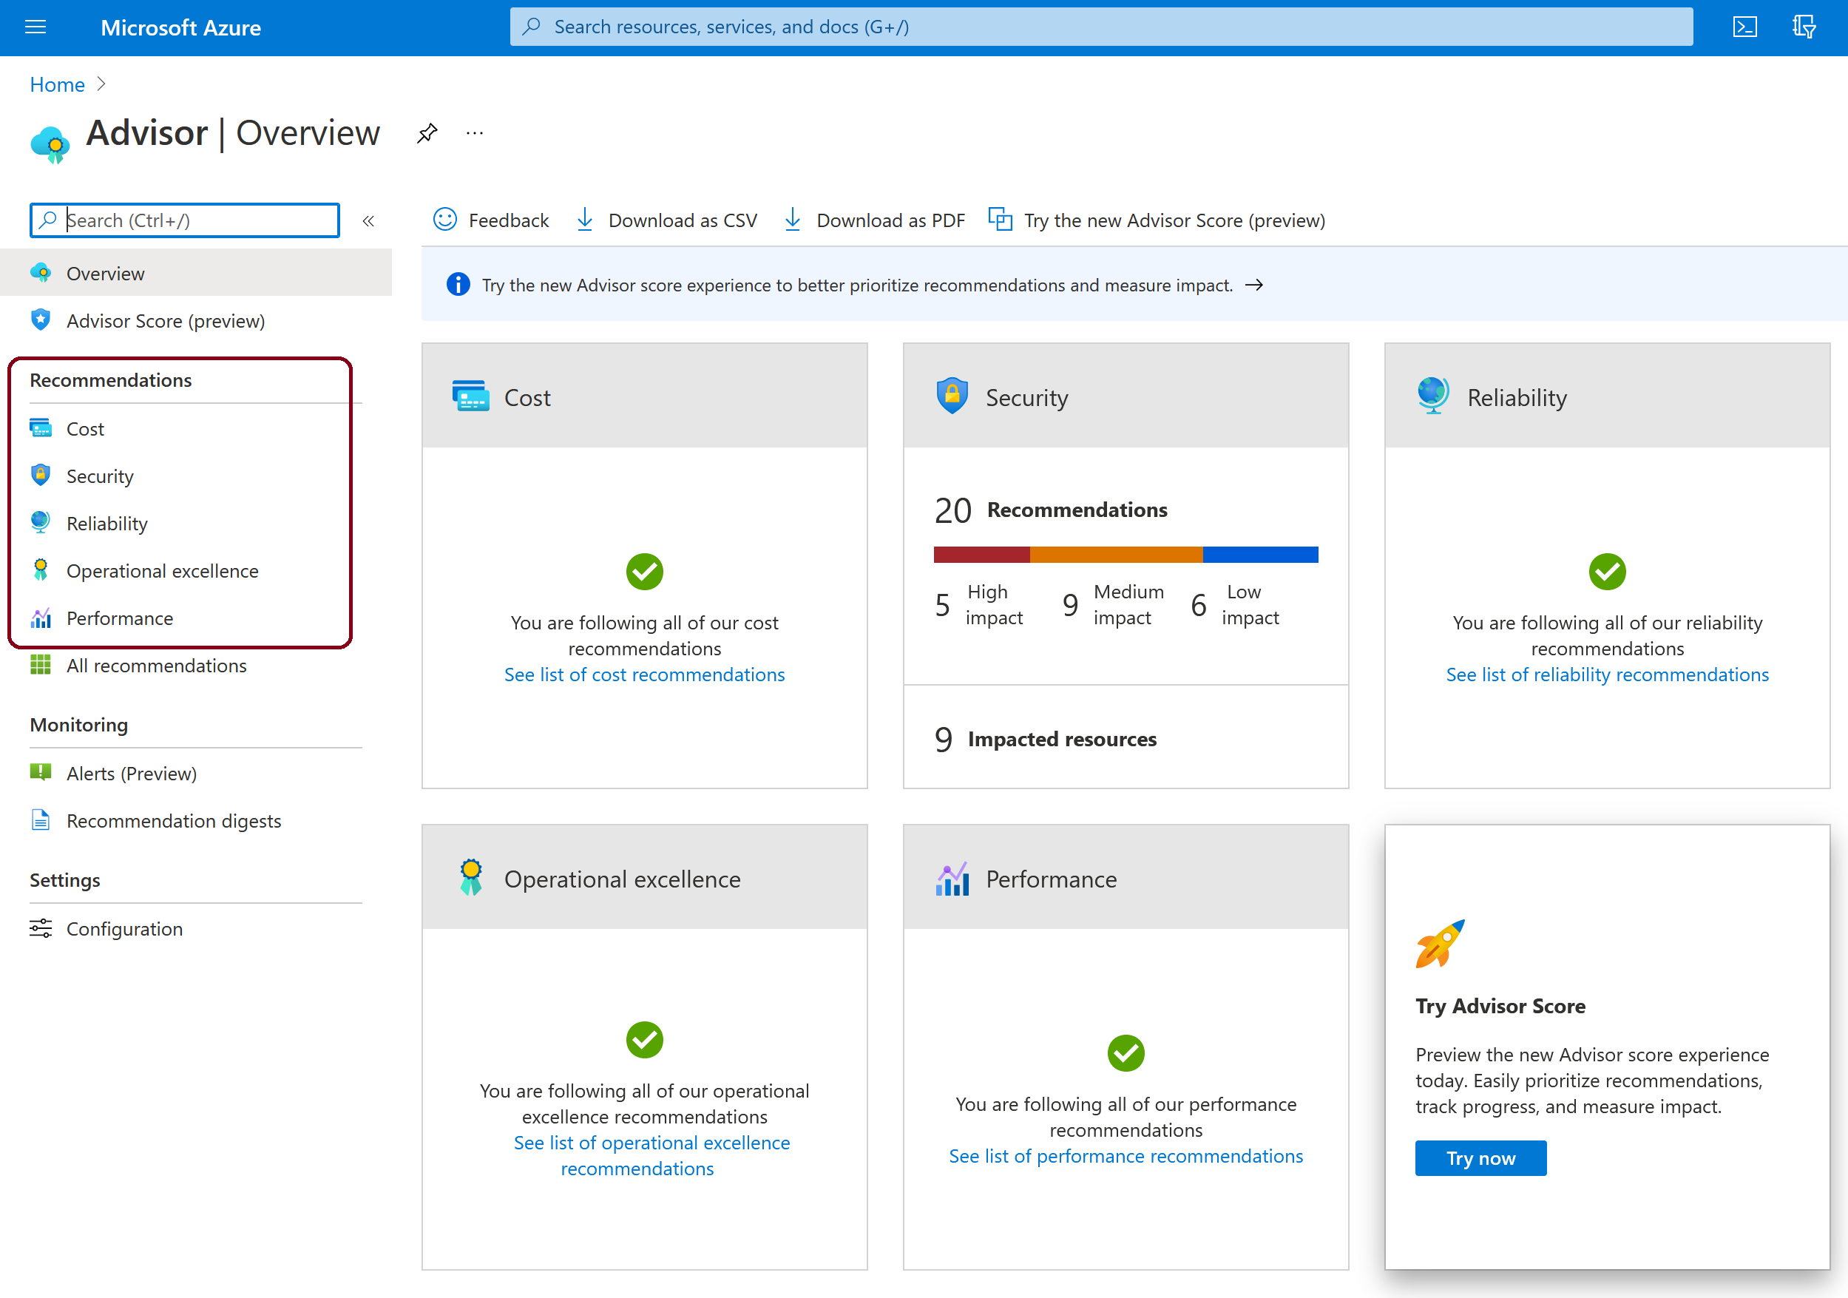
Monitor Azure Virtual Desktop by using Azure Advisor
When you open Azure Advisor, you'll see five categories:
Cost
Security
Reliability
Operational Excellence
Performance
Notes:
Whenever you come across an issue in Azure Virtual Desktop, always check Azure Advisor first. Azure Advisor will give you directions for how to solve the problem, or at least point you towards a resource that can help.

Slide 78
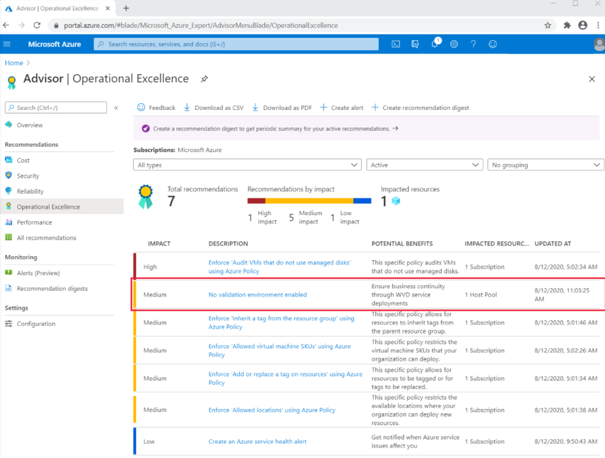
How to resolve Azure Advisor recommendations
Recommendations to be resolved can include:
No validation environment enabled
Not enough production (non-validation) environments enabled
Not enough links are unblocked to successfully implement your VM
Notes:
This slide describes how you can resolve recommendations that appear in Azure Advisor for Azure Virtual Desktop.
Common recommendations to be resolved can include:
No validation environment enabled
Not enough production (non-validation) environments enabled
Not enough links are unblocked to successfully implement your VM

Slide 79
Diagnose graphics performance issues
Graphics-related performance issues fall into four categories:
Low frame rate
Random stalls
High input latency
Poor frame quality
There are three types of Frames Skipped/Second counters:
Frames Skipped/Second (Insufficient Server Resources)
Frames Skipped/Second (Insufficient Network Resources)
Frames Skipped/Second (Insufficient Client Resources)
Notes:
To diagnose experience quality issues with your remote sessions, counters have been provided under the RemoteFX Graphics section of Performance Monitor. This unit helps you pinpoint and fix graphics-related performance bottlenecks during Remote Desktop Protocol (RDP) sessions using these counters.

Slide 80
AVD identity and security

Slide 81
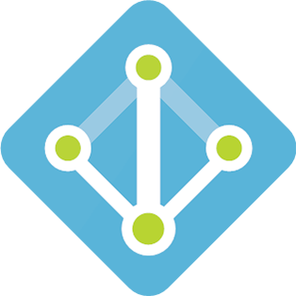
Hybrid Identity with Azure Active Directory
You can use the following authentication methods to implement hybrid identity with Azure AD
Password hash synchronization (PHS)
Pass-through authentication (PTA)
Federation (AD FS)
Notes:
rganizations are a mixture of on-premises and cloud applications. Users require access to those applications both on-premises and in the cloud.
Microsoft identity spans on-premises and cloud-based capabilities. These solutions create a common user identity for authentication and authorization to all resources, regardless of location. We call this hybrid identity. Using hybrid identity to Azure AD and hybrid identity management these scenarios possible.
To achieve hybrid identity with Azure AD, one of three authentication methods can be used, depending on your scenarios. The three methods are:
Password hash synchronization (PHS)
Pass-through authentication (PTA)
Federation (AD FS)
These authentication methods also provide single-sign on capabilities. Single-sign on automatically signs your users in when they are on their corporate devices, connected to your corporate network.

Slide 82
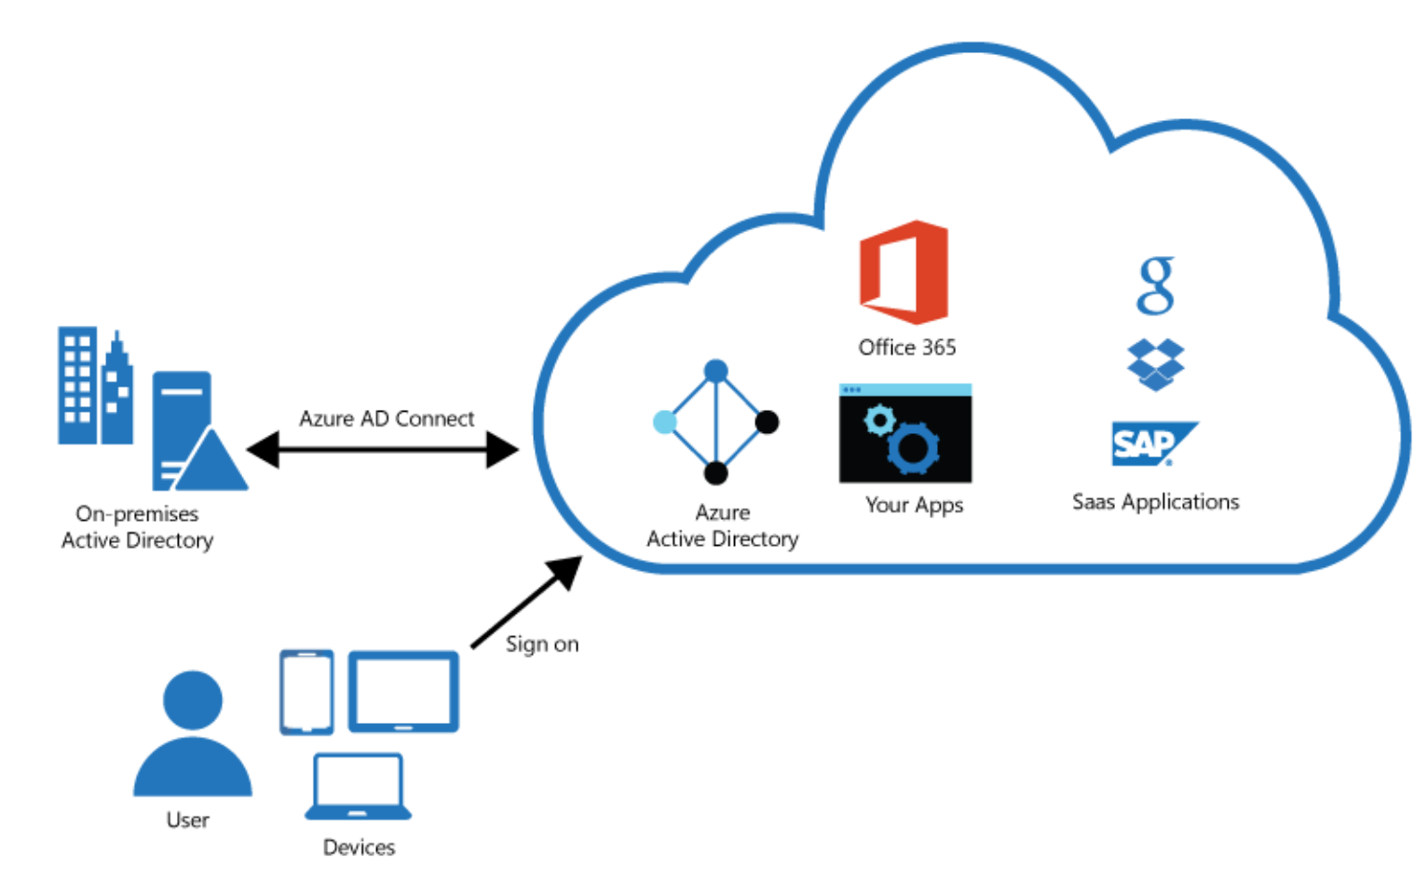
Plan for Azure AD Connect for user identities
Integrating on-premises directories with Azure AD provides a common identity for accessing both cloud and on-premises resources.
Users can use a single identity to access on-premises applications and cloud services such as Office 365.
Single tool to provide an easy deployment experience for synchronization and sign-in.
Azure AD Connect replaces older versions of identity integration tools such as DirSync and Azure AD Sync.
Notes:
To keep Windows Server Active Directory in sync with Azure Active Directory, you can configure Azure AD Connect (for hybrid organizations).
Azure Virtual Desktop supports hybrid identities through Azure Active Directory (AD), including those federated using Active Directory Federation Services (ADFS).
Since users must be discoverable through Azure AD, Azure Virtual Desktop doesn't support standalone Active Directory deployments with ADFS.
Azure Virtual Desktop currently doesn't support Active Directory Federation Services (ADFS) for SSO.
The only way to avoid being prompted for your credentials for the session host is to save them in the client. We recommend you only do this with secure devices to prevent other users from accessing your resources.
Windows 10 Enterprise multi-session is currently supported to be hybrid Azure AD-joined. After Windows 10 Enterprise multi-session is domain-joined, use the existing Group Policy Object to enable Azure AD registration.

Slide 83
Plan for Azure AD Connect for user identities (Cont)
Password hash synchronization - A sign-in method that synchronizes a hash of a users on-premises AD password with Azure AD.
Pass-through authentication - A sign-in method that allows users to use the same password on-premises and in the cloud but doesn't require the additional infrastructure of a federated environment.
Federation integration - Is used to configure a hybrid environment using an on-premises AD FS infrastructure. It also provides AD FS management capabilities such as certificate renewal and additional AD FS server deployments.
Synchronization - Responsible for creating users, groups, and other objects. As well as, making sure identity information for your on-premises users and groups is matching the cloud.
Health Monitoring - Azure AD Connect Health can provide robust monitoring and provide a central location in the Azure portal to view this activity.

Slide 84
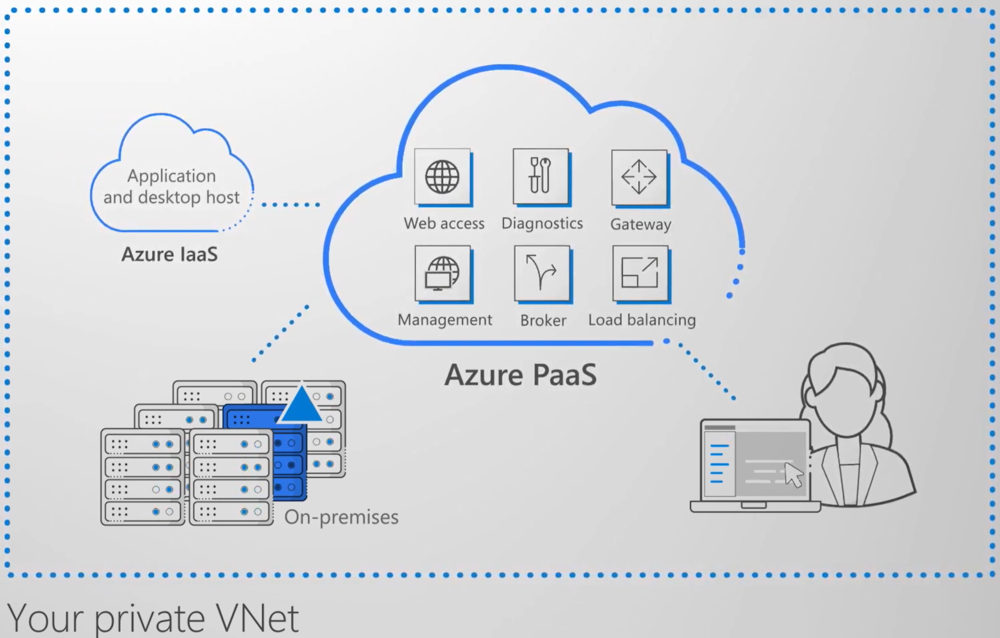
Communication between Azure resources is done by one of the following:
Through a virtual network: Deploy VMs, and several other types of Azure resources to a virtual network
Through a virtual network service endpoint: Extend your virtual network private address space and the identity of your virtual network to Azure service resources over a direct connection.
Through VNet Peering: Connect virtual networks to each other, enabling resources in either virtual network to communicate with each other, using virtual network peering
Notes:
Azure virtual network enables Azure resources to securely communicate with each other, the internet, and on-premises networks.
Key scenarios that you can accomplish using a virtual network include:
Communication of Azure resources with the internet
Communication between Azure resources
Communication with on-premises resources
Filtering network traffic
Routing network traffic
Integration with Azure services
Communicate with the internet
Resources in a VNet can communicate outbound to the internet, by default. You can communicate inbound to a resource by assigning a public IP address or a public Load Balancer. You can also use public IP or public Load Balancer to manage outbound connections.
When using only an internal Standard Load Balancer, outbound connectivity is not available until you define how you want outbound connections to work with an instance-level public IP or a public Load Balancer.
Communicate between Azure resources
Azure resources communicate securely with each other in one of the following ways:
Through a virtual network: You can deploy VMs, and several other types of Azure resources to a virtual network, such as Azure App Service Environments, the Azure Kubernetes Service (AKS), and Azure Virtual Machine Scale Sets.
Through a virtual network service endpoint: Extend your virtual network private address space and the identity of your virtual network to Azure service resources, such as Azure Storage accounts and Azure SQL Database, over a direct connection. Service endpoints allow you to secure your critical Azure service resources to only a virtual network.
Through VNet Peering: You can connect virtual networks to each other, enabling resources in either virtual network to communicate with each other, using virtual network peering. The virtual networks you connect can be in the same, or different, Azure regions.

Slide 85
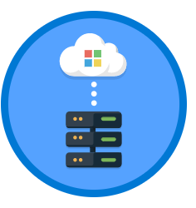
Point-to-site virtual private network (VPN):
Each computer that wants to establish connectivity with a virtual network must configure its connection.
The communication between a computer and a virtual network is sent through an encrypted tunnel over the internet.
Site-to-site VPN: Established between on-premises VPN device and an Azure VPN Gateway that is deployed in a virtual network.
Enables any on-premises resource that you authorize to access a virtual network.
The communication between an on-premises VPN device and an Azure VPN gateway is sent through an encrypted tunnel over the internet.
Azure ExpressRoute: Established between your network and Azure, through an ExpressRoute partner.
This connection is private.
Traffic does not go over the internet.
Notes:
Filter network traffic
You can filter network traffic between subnets using either or both of the following options:
Network security groups (NSGs): Network security groups and application security groups can contain multiple inbound and outbound security rules that enable you to filter traffic to and from resources by source and destination IP address, port, and protocol.
Network virtual appliance (NVA): A network virtual appliance is a VM that performs a network function, such as a firewall, WAN optimization, or other network function.
Route network traffic
Azure routes traffic between subnets, connected virtual networks, on-premises networks, and the Internet, by default. You can implement either or both of the following options to override the default routes Azure creates:
Route tables: You can create custom route tables with routes that control where traffic is routed to for each subnet.
Border gateway protocol (BGP) routes: If you connect your virtual network to your on-premises network using an Azure VPN Gateway or ExpressRoute connection, you can propagate your on-premises BGP routes to your virtual networks.
Virtual network integration for Azure services
Integrating Azure services to an Azure virtual network enables private access to the service from virtual machines or compute resources in the virtual network. You can integrate Azure services in your virtual network with the following options:
Deploying dedicated instances of the service into a virtual network. The services can then be privately accessed within the virtual network and from on-premises networks.
Using Private Link to access privately a specific instance of the service from your virtual network and from on-premises networks.
You can also access the service using public endpoints by extending a virtual network to the service, through service endpoints. Service endpoints allow service resources to be secured to the virtual network.

Slide 86

1. When authenticated in Azure Active Directory, a token is returned to the Remote Desktop Services client.
2. The gateway checks the token with the connection broker.
3. The broker queries the Azure SQL database for resources assigned to the user.
4. The gateway and the broker select the session host for the connected client.
5. The session host creates a reverse connection to the client by using the Azure Virtual Desktop gateway.
Notes:
Azure Virtual Desktop uses Remote Desktop Protocol (RDP) to provide remote display and input capabilities over network connections.
The connection data flow for Azure Virtual Desktop starts with a DNS lookup for the closest Azure datacenter.
The image above shows the five-step connection process for Azure Virtual Desktop running in Azure.
The inbound ports are not opened and the gateway is acting as an intelligent reverse proxy. The gateway manages all session connectivity.
Azure Virtual Desktop hosts the client on the session hosts running on Azure. Microsoft manages portions of the services on the customer's behalf and provides secure endpoints for connecting clients and session hosts. The diagram below gives a high-level overview of the network connections used by Azure Virtual Desktop.

Slide 87
AVD user environments

Slide 88

FSLogix profile containers
FSLogix is designed to roam profiles in remote computing environments, such as Azure Virtual Desktop.
Stores a complete user profile in a single container.
At sign in, this container is dynamically attached to the computing environment using natively supported Virtual Hard Disk (VHD) and Hyper-V Virtual Hard disk (VHDX).
The user profile is immediately available and appears in the system exactly like a native user profile.
Notes:
The Azure Virtual Desktop service recommends FSLogix profile containers as a user profile solution. FSLogix is designed to roam profiles in remote computing environments, such as Azure Virtual Desktop. It stores a complete user profile in a single container.
At sign in, this container is dynamically attached to the computing environment using natively supported Virtual Hard Disk (VHD) and Hyper-V Virtual Hard disk (VHDX). The user profile is immediately available and appears in the system exactly like a native user profile.
User profiles
A user profile contains data elements about an individual, including configuration information like desktop settings, persistent network connections, and application settings. By default, Windows creates a local user profile that is tightly integrated with the operating system.
A remote user profile provides a partition between user data and the operating system. It allows the operating system to be replaced or changed without affecting the user data. In Remote Desktop Session Host (RDSH) and Virtual Desktop Infrastructures (VDI), the operating system may be replaced for the following reasons:
An upgrade of the operating system
A replacement of an existing Virtual Machine (VM)
A user being part of a pooled (non-persistent) RDSH or VDI environment

Slide 89
Performance: The FSLogix profile containers are high performance and resolve performance issues that have historically blocked cached exchange mode.
OneDrive: Without FSLogix profile containers, OneDrive for Business is not supported in non-persistent RDSH or VDI environments.
Additional folders: FSLogix provides the ability to extend user profiles to include additional folders.
FSLogix profile containers' performance and features take advantage of the cloud using Azure Files authentication with Azure Active Directory Domain Service (AD DS).
By addressing both cost and administrative overhead, Azure Files with Azure AD DS Authentication is the preferred solution for user profiles in the Azure Virtual Desktop service.
Notes:
FSLogix addresses many profile container challenges. Key among them are:
Performance: The FSLogix profile containers are high performance and resolve performance issues that have historically blocked cached exchange mode.
OneDrive: Without FSLogix profile containers, OneDrive for Business is not supported in non-persistent RDSH or VDI environments.
Additional folders: FSLogix provides the ability to extend user profiles to include additional folders.
Azure Files integration with Azure Active Directory Domain Service
FSLogix profile containers' performance and features take advantage of the cloud using Azure Files authentication with Azure Active Directory Domain Service (AD DS). By addressing both cost and administrative overhead, Azure Files with Azure AD DS Authentication is a premium solution for user profiles.
Azure Virtual Desktop offers full control over size, type, and count of VMs that are being used by customers.
To ensure your Azure Virtual Desktop environment follows best practices:
Azure Files storage account must be in the same region as the session host VMs.
Azure Files permissions should match permissions described in Requirements - Profile Containers.
Each host pool VM must be built of the same type and size VM based on the same master image.
Each host pool VM must be in the same resource group to aid management, scaling and updating.
For optimal performance, the storage solution and the FSLogix profile container should be in the same data center location.
The storage account containing the master image must be in the same region and subscription where the VMs are being provisioned

Slide 90

Microsoft FSLogix Apps installs the core drivers and components for all FSLogix solutions.
Any environment using FSLogix must install FSLogix Apps.
After installation configure Profile Container before using for profile redirection.
To install FSLogix Applications:
From the FSLogix download file, select 32 bit or 64 bit depending on your environment
Run FSLogixAppSetup.exe
Click Options to specify an installation folder
FSLogix is available for download here
Notes:
The FSLogix software no longer requires license keys. It is recommended that the latest version of FSLogix is downloaded and installed.
This unit describes how to download and install FSLogix tools.
Download FSLogix
FSLogix is available for download here.
Install Microsoft FSLogix components
The download for FSLogix includes three installers that are used to install the specific component(s) necessary for your use.
Microsoft FSLogix Apps Installation
Microsoft FSLogix Apps installs the core drivers and components for all FSLogix solutions. Any environment using FSLogix must install FSLogix Apps. After installation configure Profile Container before using for profile redirection.

Slide 91
Storage options for FSLogix profile containers
Compare the storage solutions Azure Storage offers for Azure Virtual Desktop FSLogix profile container user profiles.
Features | Azure Files | Azure NetApp Files | Storage Spaces Direct
Use case | General purpose | Ultra performance or migration from NetApp on-premises | Cross-platform
Platform service | Yes, Azure-native solution | Yes, Azure-native solution | No, self-managed
Regional availability | All regions | Select regions | All regions
Redundancy | Locally redundant/zone-redundant/geo-redundant/geo-zone-redundant | Locally redundant | Locally redundant/zone-redundant/geo-redundant
Tiers and performance | Standard (Transaction optimized) Premium Up to max 100K IOPS per share with 10 GBps per share at about 3 ms latency | Standard Premium Ultra Up to 320k (16K) IOPS with 4.5 GBps per volume at about 1 ms latency | Standard HDD: up to 500 IOPS per-disk limits Standard SSD: up to 4k IOPS per-disk limits Premium SSD: up to 20k IOPS per-disk limits We recommend Premium disks for Storage Spaces Direct
Capacity | 100 TiB per share, Up to 5 PiB per general purpose account | 100 TiB per volume, up to 12.5 PiB per subscription | Maximum 32 TiB per disk
Required infrastructure | Minimum share size 1 GiB | Minimum capacity pool 4 TiB, min volume size 100 GiB | Two VMs on Azure IaaS (+ Cloud Witness) or at least three VMs without and costs for disks
Protocols | SMB 3.0/2.1, NFSv4.1 (preview), REST | NFSv3, NFSv4.1 (preview), SMB 3.x/2.x | NFSv3, NFSv4.1, SMB 3.1
Notes:
This slide compares storage solutions that Azure offers for Azure Virtual Desktop FSLogix user profile containers.
See: https://docs.microsoft.com/en-us/azure/virtual-desktop/store-fslogix-profile
It's best to store FSLogix profile containers on Azure Files.
FSLogix is designed to roam profiles in remote computing environments, such as Azure Virtual Desktop.
At sign-in, this container is dynamically attached to the computing environment using a natively supported Virtual Hard Disk (VHD) and a Hyper-V Virtual Hard Disk (VHDX).
The user profile is immediately available and appears in the system exactly like a native user profile.
The following tables compare the storage solutions Azure Storage offers for Azure Virtual Desktop FSLogix profile container user profiles.

Slide 92
Profile Container vs Office Container
Profile Container
Profile Container is used to redirect the full user profile.
Profile Container is used in non-persistent, virtual environments, such as Virtual Desktops.
When using Profile Container, the entire user profile, except for data that is excluded using the redirections.xml, is included in the profile container.
For users familiar with managing profiles in non-persistent environments, the function of Profile Container may be compared to Microsoft User Profile Disk, Microsoft Roaming Profiles, or Citrix UPM.
Office Container
Office Container is designed to improve the performance of Microsoft Office in non-persistent environments.
As opposed to Profile Container, Office Container redirects only the local user files for Microsoft Office.
When configuring Office Container, each Office component is independently included based on the selected settings to include data for specific office components.
When Office Container is used with other profile solutions, it's that those solutions are configured to exclude certain data.
Notes:
Office Container is a subset of Profile Container. Although all the benefits of Office Container are also delivered from Profile Container, there are times when it may be beneficial to use them together.
Profile Container and Office Container are configured differently. It's important to completely understand the configuration process, especially when using them together.
Profile Container
Profile Container is used to redirect the full user profile. Profile Container is used in non-persistent, virtual environments, such as Virtual Desktops. When using Profile Container the entire user profile, except for data that is excluded using the redirections.xml, is included in the profile container.
For users familiar with managing profiles in non-persistent environments, the function of Profile Container may be compared to Microsoft User Profile Disk, Microsoft Roaming Profiles, or Citrix UPM.
Office Container
Office Container is generally implemented with another profile solution, and is designed to improve the performance of Microsoft Office in non-persistent environments. As opposed to Profile Container, Office Container redirects only the local user files for Microsoft Office. When configuring Office Container, each Office component is independently included based on the selected settings to include data for specific office components.
When Office Container is used with other profile solutions, it's that those solutions are configured to exclude certain data.
The data contained in the Office Container can be re-created from various server locations. As an example, the .OST file is generated from the email server(S), if the file is lost or damaged it may be recovered.
Using Profile Container and Office Container together
There are several reasons why Profile Container and Office Container may be used together. The most common reasons are:
Discretion is wanted in the storage location for Office Data vs. other profile data
If the Office Container or Profile Container is damaged, the remaining data remains intact. Storage discretion is useful if there is a problem with Office Data, which can be recovered from the server as the Office Container can be deleted without impacting the rest of the user configuration.
Office Container may be used with Profile Container as a mechanism to specify which Office components will have their data included in the container

Slide 93

Configure Office Container
Applications and users see the portions of the profile managed by Office Container as if they're located on the local drive.
All benefits of Office Container are automatic when using Profile Container.
There's no need to implement Office Container if Profile Container is your primary solution for managing profiles.
Notes:
Using Office Container, both applications and users see the portions of the profile managed by Office Container as if they're located on the local drive.
All benefits of Office Container are automatic when using Profile Container.
There's no need to implement Office Container if Profile Container is your primary solution for managing profiles.
Office Container could optionally be used with Profile Container, to place Office Data in a location separate from the rest of the user's profile.
In this unit, learn how to:
Configure Office Container Registry settings.
Set up Include and Exclude User Groups.
Configure third party profile exclusions.

Slide 94
Configure Cloud Cache
Cloud Cache is an optional add-on to Profile Container and Office Container.
Configure Cloud Cache for SMB (Profile Container)
All settings are applied to HKLM\SOFTWARE\FSLogix\Profiles.
Registry Value | Type | Value
CCDLocations | REG_SZ / MULTI_SZ | type=smb,connectionString=<\Location1\Folder1>;type=smb,connectionString=<\Location2\folder2>
Enabled | DWORD | 1
Configuring Cloud Cache for Office Container
All settings are applied to HKLM\SOFTWARE\FSLogix\ODFC
Registry Value | Type | Value
CCDLocations | REG_SZ / MULTI_SZ | type=smb,connectionString=<\Location1\Folder1>;type=smb,connectionString=<\Location2\folder2>
Enabled | DWORD | 1
Configuring Cloud Cache for Profile Container
Registry Value | Type | Value
CCDLocations | REG_SZ / MULTI_SZ | type=azure,connectionString="DefaultEndpointsProtocol=https;AccountName=;AccountKey=;EndpointSuffix="
Enabled | DWORD | 1
Notes:
Cloud Cache is an optional add-on to Profile Container and Office Container.
In this unit you will:
Configure Cloud Cache for Server Message Block (SMB).
Configure Cloud Cache for page blobs.
Below are required ahead of time.
Install FSLogix.
Verify that users have appropriate access to network file storage.
If using page blobs for Cloud Cache, verify that an appropriate Azure storage service is being used.

Slide 95

Profile Container is a full remote profile solution for non-persistent environments.
Profile Container redirects the entire user profile to a remote location.
Profile Container configuration defines how and where the profile is redirected.
Profile Container is inclusive of the benefits found in Office Container.
When using Profile Container, both applications and users see the profile as if it's located on the local drive.
Notes:
Profile Container is a full remote profile solution for non-persistent environments. Profile Container redirects the entire user profile to a remote location. Profile Container configuration defines how and where the profile is redirected.
Profile Container is inclusive of the benefits found in Office Container.
When using Profile Container, both applications and users see the profile as if it's located on the local drive.
In this unit, learn how to:
Configure Profile Container Registry Settings.
Set up Include and Exclude User Groups.

Slide 96
Minimize graphic redraws, effects, and background activities that have no major benefit to the virtual desktop environment and reduce running processes to the bare minimum.
Use a "base" operating system image as the basis for the desktops:
Persistent: preserves changes to the virtual desktop operating system from one session to the next.
Non-persistent: does not preserve changes to the virtual desktop operating system from one session to the next.
Use a VM to build a VM:
State can be saved
Checkpoints can be set
Backups can be performed
A default OS installation is performed to the base VM
VM is then optimized by removing unneeded apps
Install Windows updates, delete temporary files, applying settings, etc...
Notes:
The guiding principles to optimize performance of Windows 10 in a virtual desktop environment are to minimize graphic redraws and effects, background activities that have no major benefit to the virtual desktop environment, and generally reduce running processes to the bare minimum.
A secondary goal is to reduce disk space usage in the base image to the bare minimum.
With virtual desktop implementations, the smallest possible base, or "gold" image size, can slightly reduce memory utilization on the host system, as well as a small reduction in overall network operations required to deliver the desktop environment to the consumer.
Optimization principles
Some implementations of virtual desktop environments use a "base" operating system image, which then becomes the basis for the desktops subsequently presented to the users for work. There are persistent and non-persistent base images.
The persistent type preserves changes to the virtual desktop operating system from one session to the next. The non-persistent type does not preserve changes to the virtual desktop operating system from one session to the next. To the user this desktop is little different than other virtual or physical device, other than it is accessed over a network.
The optimization settings could take place on a reference machine. A virtual machine (VM) would be an ideal place to build the VM, because state can be saved, checkpoints can be made, backups can be made, and so on. A default OS installation is performed to the base VM. That base VM is then optimized by removing unneeded apps, installing Windows updates, installing other updates, deleting temporary files, applying settings, and so on.
Updates
Windows 10 utilizes a monthly update rhythm. In some cases virtual desktop administrators control the process of updating through a process of shutting down VMs based on a "master" or "gold" image, unseal that image which is read-only, patch the image, then reseal it and bring it back into production. Therefore, there is no need to have virtual desktop devices checking Windows Update.
There is a set of scripts available at GitHub.com , that will do all the work items mentioned here.
The Internet URL for the optimization scripts can be found at https://github.com/The-Virtual-Desktop-Team/Virtual-Desktop-Optimization-Tool .

Slide 97
Persistent virtual desktop is a device that saves operating system state in between reboots.
Traditional VMs, where the VM has its own virtual disk file, starts up normally, and saves changes from one session to the next.
Image-based persistent VMs, a base/gold image on one or more host servers.
Master/gold image, where updates are applied.
A non-persistent virtual desktop implementation is based on a base or "gold" image.
The base image is read-only.
When started, a copy of the base image is streamed to the VM.
All activity until the next reboot is redirected to a temporary location.
Users are provided network locations to store their data.
Notes:
Persistent virtual desktop saves the operating system state in between reboots. Other software layers of the virtual desktop solution provide the users easy and seamless access to their assigned VMs, often with a single sign-on solution.
There are several different implementations of persistent virtual desktop.
Traditional VMs, where the VM has its own virtual disk file, starts up normally, and saves changes from one session to the next. The difference is how the user accesses this VM. There may be a web portal the user signs in to that automatically directs the user to one or more virtual desktop devices (VMs) assigned to them.
Image-based persistent VMs, optionally with personal virtual disks (PVD). In this type of implementation, there is a base/gold image on one or more host servers. A VM is created, and one or more virtual disks are created and assigned to this disk for persistent storage.
When the VM is started, a copy of the base image is read into the memory space of that VM. At the same time, a persistent virtual disk assigned to that VM, with any previous OS deltas is merged through a complex process.
Changes such as event log writes and log writes are redirected to the read/write virtual disk assigned to that VM.
In this circumstance, OS and app servicing may operate normally, using traditional servicing software such as Windows Server Update Services, or other management technologies.
Master/gold image. The difference between a persistent virtual desktop device and a "normal" virtual desktop device is the relationship to the master/gold image. Eventually updates must be applied to the master. It is at this point where organizations decide how the user persistent changes are handled. In some cases, the disk with the user changes is discarded or reset. It may also be that the changes the user makes to the machine are kept through monthly Quality Updates, and the base is reset following a Feature Update.

Slide 98
Configure user settings through group policies
Setting area | Setting | Recommended value
Background Intelligent Transfer Service (BITS)
 | Do not allow the BITS client to use Windows Branch Cache | Enabled
 | Do not allow the computer to act as a BITS Peercaching client | Enabled
 | Do not allow the computer to act as a BITS Peercaching server | Enabled
 | Allow BITS Peercaching | Disabled
BranchCache
 | Turn on BranchCache | Disabled
Hotspot Authentication
 | Enable Hotspot Authentication | Disabled
Microsoft Peer-to-Peer Networking Services
 | Turn off Microsoft Peer-to-Peer Networking Services | Enabled
Offline Files
 | Allow or Disallow use of the Offline Files feature | Disabled
Notes:
There are opportunities for you to refine the Windows 10 operating system specifically for your Azure Virtual Desktop environment.
Some recommendations might disable functionality that you would prefer to use, so you should consider the cost versus the benefit of adjusting any setting.
Creating the Windows 10 image
The first step is to install a reference image of Windows 10 on either a physical or virtual machine. Installing to a virtual machine is easy and allows you to save versions of the virtual hard-disk (VHD) file, in case you want to roll back to an earlier version.
During installation, you can choose either Express Settings or Customize. The settings offered during the Customize option are adjustable by using Group Policy, so the method of installing the base OS is not that important.

Slide 99

Enroll Azure Virtual Desktop VMs that are hybrid Azure AD joined with Microsoft Intune and manage them in the Microsoft Endpoint Manager admin center as you would physical devices.
Endpoint Manager integration is available for Windows 10 Enterprise desktops.
Notes:
Microsoft Endpoint Manager integrates with Azure Virtual Desktop to manage and operate deployments efficiently and establish a secure remote work solution.
You can enroll Azure Virtual Desktop Virtual Machines that are hybrid Azure AD joined (joined to your on-premises Active Directory and registered with your Azure Active Directory) with Microsoft Intune and manage them in the Microsoft Endpoint Manager admin center the same way as physical devices.
Microsoft Endpoint Manager simplifies management, provides a centralized view across both physical devices and virtual desktops and opens up new areas of collaboration. The Endpoint Manager integration is generally available for Windows 10 Enterprise desktops. Windows 10 Enterprise multi-session supports policies at device specific scope.

Slide 100

Configure session timeout properties
Signing users out when they're inactive preserves resources and prevents access by unauthorized users.
The timeout options for RDP is set on the servers in the Local Group Policy:
Set time limit for disconnected sessions
Set time limit for active but idle Remote Desktop Services sessions
Set time limit for active Remote Desktop Services sessions
End Session when time limits are reached

Slide 101

Universal Print manages print infrastructure through cloud services from Microsoft.
Universal Print runs entirely on Microsoft Azure.
With Universal Print–compatible printers, it doesn't require on-premises infrastructure.
A Microsoft 365 subscription-based service that centralizes print management through the Universal Print portal.
Integrated with Azure Active Directory and supports single sign-on scenarios.
Can be deployed with non-compatible printers by using Universal Print connector software.
Notes:
Universal Print is a modern print solution that organizations can use to manage their print infrastructure through cloud services from Microsoft.
Universal Print runs entirely on Microsoft Azure. When it's deployed with Universal Print–compatible printers, it doesn't require any on-premises infrastructure.
Universal Print is a Microsoft 365 subscription-based service that organizations use to centralize print management through the Universal Print portal. It's fully integrated with Azure Active Directory and supports single sign-on scenarios.
Universal Print can be deployed with non-compatible printers by using Universal Print connector software.

Slide 102

Troubleshoot user profile issues
To report issues or suggest features for Azure Virtual Desktop with Azure Resource Manager integration, visit the Azure Virtual Desktop Tech Community.
Use the Tech Community to discuss best practices or suggest and vote for new features.
When you make a post asking for help or propose a new feature, make sure you describe your topic in as much detail as possible.
Notes:
This unit provides an overview of the issues you may encounter when setting up an Azure Virtual Desktop environment and provides ways to resolve the issues.
Report issues
To report issues or suggest features for Azure Virtual Desktop with Azure Resource Manager integration, visit the Azure Virtual Desktop Tech Community.

Slide 103
Troubleshoot Azure Virtual Desktop clients
Remote Desktop client for Windows 10 stops responding or cannot be opened
You can reset the user data from the About page or using a command.
Use the following command to remove your user data, restore default settings and unsubscribe from all Workspaces.
msrdcw.exe /reset [/f]
Web client won't open
First, test your internet connection by opening another website in your browser.
Use nslookup to confirm DNS can resolve the FQDN:
nslookup rdweb.WVD.microsoft.com
Try connecting with another client (eg, Remote Desktop client for Windows 10) to see if you can open the web client.
Web client keeps prompting for credentials
If the Web client keeps prompting for credentials, follow these instructions:
Confirm the web client URL is correct.
Confirm that the credentials you're using are for the Azure Virtual Desktop environment tied to the URL.
Clear browser cookies.
Clear browser cache.
Open your browser in Private mode.
Notes:
This unit describes common issues with the Remote Desktop client and how to fix them.

Slide 104

MSIX app attach
The MSIX package format preserves the functionality of existing app packages and/or install files in addition to enabling new, modern packaging and deployment features to Win32, WPF, and Windows Forms apps.
MSIX app attach is a way to deliver MSIX applications to both physical and virtual machines.
MSIX app attach is different from regular MSIX because it's made especially for Azure Virtual Desktop.
In an Azure Virtual Desktop deployment, MSIX app attach can:
Create separation between user data, the OS, and apps by using MSIX containers.
Remove the need for repackaging when delivering applications dynamically.
Reduce the time it takes for a user to sign in.
Notes:
MSIX is a Windows app package format that provides a modern packaging experience to all Windows apps. The MSIX package format preserves the functionality of existing app packages and/or install files in addition to enabling new, modern packaging and deployment features to Win32, WPF, and Windows Forms apps.
MSIX app attach is a way to deliver MSIX applications to both physical and virtual machines. However, MSIX app attach is different from regular MSIX because it's made especially for Azure Virtual Desktop.
Application delivery options in Azure Virtual Desktop
You can deliver apps in Azure Virtual Desktop through one of the following methods:
Put apps in a master image
Use tools like SCCM or Intune for central management
Dynamic app provisioning (AppV, VMWare AppVolumes, or Citrix AppLayering)
Create custom tools or scripts using Microsoft and a third-party tool
What does MSIX app attach do?
In an Azure Virtual Desktop deployment, MSIX app attach can:
Create separation between user data, the OS, and apps by using MSIX containers.
Remove the need for repackaging when delivering applications dynamically.
Reduce the time it takes for a user to sign in.
Reduce infrastructure requirements and cost.

Slide 105

How MSIX app attach works
From the Azure Virtual Desktop client, you sign in and select the host pool for which you have access.
You're assigned a virtual machine within the host pool, on which a RemoteApp or Remote Desktop session is created.
If the user profile is configured, the FSLogix agent on the session host provides the user profile from the file share.
Applications that are assigned to you are read from Azure Virtual Desktop.
MSIX app attach applications are registered to the virtual machine for you, from the attached MSIX virtual disk.
Notes:
MSIX app attach stores application files in a separate virtual hard disk from the operating system. It registers the regular MSIX package on a device instead of on a physical download and installation. The registration uses existing Windows APIs and has minimal impact on user sign-in times, which enhances the user experience.
When you open MSIX app attach, the application files are accessed from a VHD. You're not even aware that the application isn't locally installed.
After you open MSIX app attach, you experience the following process:
From the Azure Virtual Desktop client, you sign in and select the host pool for which you have access. The process is similar to opening published RemoteApp programs from the Azure Virtual Desktop environment.
You're assigned a virtual machine within the host pool, on which a RemoteApp or Remote Desktop session is created. The Azure Virtual Desktop client interacts with that session.
If the user profile is configured, the FSLogix agent on the session host provides the user profile from the file share. The file share can be Azure Files, Azure NetApp Files, or an infrastructure as a service (IaaS) file server.
Applications that are assigned to you are read from Azure Virtual Desktop.
MSIX app attach applications are registered to the virtual machine for you, from the attached MSIX virtual disk. That virtual disk might be on an IaaS file share, Azure Files, or Azure NetApp Files.

Slide 106
Set up a file share for MSIX app attach
To optimize MSIX app attach performance:
The storage for MSIX app attach should be in the same datacenter location as the session hosts.
To prevent bottlenecks, exclude the following VHD, VHDX, and CIM files from antivirus scans:
<MSIXAppAttachFileShare\>\*.VHD
<MSIXAppAttachFileShare\>\*.VHDX
\\storageaccount.file.core.windows.net\share*.VHD
\\storageaccount.file.core.windows.net\share*.VHDX
<MSIXAppAttachFileShare>.CIM
\\storageaccount.file.core.windows.net\share**.CIM
Separate the storage fabric for MSIX app attach from FSLogix profile containers.
All VM system accounts and user accounts must have read-only permissions to the file share.
Disaster recovery plans must include replicating the MSIX app attach file share in your secondary failover location.
Notes:
All MSIX images must be stored on a network share that can be accessed by users in a host pool with read-only permissions.
MSIX app attach doesn't have any dependencies on the type of storage fabric the file share uses. The considerations for the MSIX app attach share are same for an FSLogix share.

Slide 107

Before you can start uploading the images, you'll need to set up Azure NetApp Files.
To start using Azure NetApp Files:
Set up your Azure NetApp Files account.
Create a capacity pool.
Join an Azure Active Directory (Azure AD) connection.
Create a new volume.
Make sure your connection to the Azure NetApp Files share works.
Notes:
To start using Azure NetApp Files:
Set up your Azure NetApp Files account by following the instructions in Set up your Azure NetApp Files account.
Create a capacity pool by following the instructions in Set up a capacity pool.
Join an Azure Active Directory (Azure AD) connection by following the instructions in Join an Active Directory connection.
Create a new volume by following the instructions in Create a new volume and Configure volume access parameters.
Make sure your connection to the Azure NetApp Files share works by following the instructions in Make sure users can access the Azure NetApp Files share.
With Azure NetApp Files share setup, you can start uploading images to it.
To upload an MSIX image to your Azure NetApp Files share:
In each session host, install the certificate that you signed the MSIX package with. Make sure to store the certificates in the folder named Trusted People.
Copy the MSIX image you want to add to the Azure NetApps Files share.
Go to File Explorer and enter the mount path, then paste the MSIX image into the mount path folder.
Your MSIX image should now be accessible to your session hosts when they add an MSIX package using the Azure portal or PowerShell.

Slide 108

Configure apps for users
In this demonstration you see how to create a RemoteApp application group to share an application to a different user in the organization.
Step 1: Create a RemoteApp application group
Step 2: Add Azure AD users or user groups
Step 3: Add applications
Step 4: Register and create an application group
Step 5: Verify access to application
Notes:
In this unit, you see how to create a RemoteApp application group to share an application to a different user in the organization.
To complete the exercise, you'll need the credentials for a different non-administrative user account that's in Active Directory.

Slide 109

Using the OneDrive sync app on virtual desktops
The OneDrive sync per machine app provides:
Automatic transitioning from the previous OneDrive for Business sync app
Automatic conversion from per-user to per-machine
Automatic updates when a new version is available
Notes:
For all supported operating systems, the OneDrive sync app supports:
Virtual desktops that persist between sessions.
Non-persistent virtual desktops that use Azure Virtual Desktop .
Non-persistent virtual desktops that have FSLogix Apps or FSLogix Office Container , and a Microsoft 365 subscription for all of the following operating systems:
Windows 10, 32 or 64-bit (supports VHDX files)
Windows 7, 32 or 64-bit (supports VHD files)
Windows Server 2019 (supports VHDX)
Windows Server 2016 (supports VHDX)
Windows Server 2012 R2 (supports VHDX)
Windows Server 2008 R2 (supports VHD)
Install the OneDrive sync app per machine
By default, the OneDrive sync app installs per user, meaning OneDrive.exe needs to be installed for each user account on the PC under the %localappdata% folder. With the new per-machine installation option, you can install OneDrive under the Program Files (x86) or Program Files directory, meaning all profiles on the computer will use the same OneDrive.exe binary. Other than where the sync app is installed, the behavior is the same.
The new per-machine sync app provides:
Automatic conversion from per-user to per-machine
Automatic updates when a new version is available
The per-machine sync app supports syncing OneDrive files in Microsoft 365 and in SharePoint Server 2019.

Slide 110

Using Microsoft Teams on Azure Virtual desktop
Media optimization for Microsoft Teams is only available for the Windows Desktop client on Windows 10 machines.
Microsoft Teams on Azure Virtual Desktop supports chat and collaboration.
With media optimizations, it also supports calling and meeting functionality.
With media optimization for Microsoft Teams, the Windows Desktop client handles audio and video locally for Teams calls and meetings.
You can still use Microsoft Teams on Azure Virtual Desktop with other clients without optimized calling and meetings.
Teams chat and collaboration features are supported on all platforms.
Notes:
Media optimization for Microsoft Teams is only available for the Windows Desktop client on Windows 10 machines.
Microsoft Teams on Azure Virtual Desktop supports chat and collaboration. With media optimizations, it also supports calling and meeting functionality.
With media optimization for Microsoft Teams, the Windows Desktop client handles audio and video locally for Teams calls and meetings. You can still use Microsoft Teams on Azure Virtual Desktop with other clients without optimized calling and meetings.
Teams chat and collaboration features are supported on all platforms. To redirect local devices in your remote session, check out Customize Remote Desktop Protocol properties for a host pool.
Before you can use Microsoft Teams on Azure Virtual Desktop:
Install the Windows Desktop client on a Windows 10 or Windows 10 IoT Enterprise.
Connect to a Windows 10 Multi-session or Windows 10 Enterprise virtual machine (VM).

Slide 111
Publish built-in apps in Azure Virtual Desktop
To publish a built-in app:
Connect to one of the virtual machines in your host pool.
Get the PackageFamilyName of the app you want to publish by following the instructions in this article .
Run the following cmdlet with <PackageFamilyName> replaced by the PackageFamilyName you found in the previous step:
New-AzWvdApplication -Name <applicationname> -ResourceGroupName <resourcegroupname> -ApplicationGroupName <appgroupname> -FilePath "shell:appsFolder\<PackageFamilyName>!App" -CommandLineSetting <Allow|Require|DoNotAllow> -IconIndex 0 -IconPath <iconpath> -ShowInPortal:$true
Azure Virtual Desktop only supports publishing apps with install locations that begin with C:\Program Files\WindowsApps.
Notes:
This unit will tell you how to publish apps, such as Microsoft Edge browser, in your Azure Virtual Desktop environment.

Slide 112

Disaster recovery for Azure Virtual Desktop
The Azure Virtual Desktop service offers BCDR to preserve customer metadata during outages.
When an outage occurs in an Azure region, the service infrastructure components will failover to a secondary location and continue functioning as expected.
For users can connect during an Azure region outage, you may need to replicate personal VMs to a different Azure region (the secondary location).
During outages, the primary region fails over to the replicated VMs in the secondary location.
Users can continue to access apps from the secondary location without interruption.
Notes:
To strengthen your organization’s Azure Virtual Desktop availability and to keep data safe, you should implement a business continuity and disaster recovery (BCDR) strategy. A good BCDR strategy keeps your apps and workloads up and running during planned and unplanned service or Azure outages. The graphic shows the recovery point objective (RPO) as the loss of data and the recovery time objective (RTO) as the time to recover from a disaster.
The Azure Virtual Desktop service offers BCDR to preserve customer metadata during outages. When an outage occurs in an Azure region, the service infrastructure components will failover to a secondary location and continue functioning as expected.
To make sure your users can still connect during an Azure region outage, you may need to replicate personal VMs to a different Azure region (the secondary location). During outages, the primary region fails over to the replicated VMs in the secondary location. Users can continue to access apps from the secondary location without interruption. In addition to VM replication, you’ll need to ensure user identities are accessible at the secondary location. Accessible identities can be achieved by using profile containers. You may also use multiple Pooled host pools with automated provisioning across regions as an alternative to VM replication.

Slide 113

VM replication
First, you'll need to replicate your VMs to the secondary location.
Options depend on how your VMs are configured:
You can configure all VMs for both pooled and personal host pools with Azure Site Recovery. You'll only need to set up one host pool and its related app groups and workspaces.
You can create a new host pool in the failover region while keeping all resources in your failover location turned off.
You need to set up new app groups and workspaces in the failover region, then use an Azure Site Recovery plan to turn host pools on.
You can create a host pool that's populated by VMs built in both the primary and failover regions while keeping the VMs in the failover region turned off.
Notes:
You'll need to replicate your VMs to the secondary location for Azure Virtual Desktop. Your options for doing so depend on how your VMs are configured:
You can configure all your VMs for both pooled and personal host pools with Azure Site Recovery. With this method, you'll only need to set up one host pool and its related app groups and workspaces.
You can create a new host pool in the failover region while keeping all resources in your failover location turned off.
You need to set up new app groups and workspaces in the failover region, then use an Azure Site Recovery plan to turn on host pools.
You can create a host pool that's populated by VMs built in both the primary and failover regions while keeping the VMs in the failover region turned off.
You only need to set up one host pool and its related app groups and workspaces.
You can use an Azure Site Recovery plan to power on host pools with this method.
Use Azure Site Recovery to manage replicating VMs in other Azure locations, as described in Azure-to-Azure disaster recovery architecture.
Set up Azure Site Recovery by replicating an Azure VM to a different Azure region directly from the Azure portal. Site Recovery is automatically updated with new Azure features as they’re released.

Slide 114


FSLogix configuration
The FSLogix agent can support multiple profile locations if you configure the registry entries for FSLogix.

